Slide 1

Aleph Pharmaceuticals
Developing a novel class of antidepressants targeting astrocytes
Dr. Jimmy Stehberg
December, 2019
Aleph
Pharmaceuticals

Slide 2
EXECUTIVE SUMMARY
Technology | Novel small molecule antidepressants targeting astrocytes
Novel cell target | First known compounds to target brain astrocytes, a cell type that participates in neuronal synapse signaling
Validated mechanism of action | By targeting Cx43 hemichannel-mediated astroglial release of D-serine and glutamate, the activity of NMDA receptors is diminished, inducing antidepressant effects like KETAMINE, but without its sedative effects.
Lead candidate with fast antidepressant effects in rodents | Lead compound with rapid (˂10 min) antidepressant effects when administered systemically in rats
Issued intellectual property | Patent granted (WO2013179264A) in US. Additional follow-on compounds in drafting.
Financing to-date | $600K Competitive Grants. $50K private investment.
Team | Expertise in drug discovery, in vitro and in vivo assays
Aleph
Pharmaceuticals

Slide 3

PROBLEMS WITH CURRENT ANTIDEPRESSANTS
50% of people with depression do not respond to current antidepressants.
Current generic and branded antidepressants take 3 weeks to exert their effects, often requiring the prescription of other drugs.
All drugs in the market target neurons but there are no drugs targeting other brain cells.
Ketamine has demonstrated rapid antidepressant effects, but side effects and abuse potential limit broad utility
Aleph
Pharmaceuticals

Slide 4
KETAMINE: VALIDATED ANTIDEPRESSANT ACTIVITY VIA NMDAR
MDD patients show abnormalities in NMDAR-mediated glutamate transmission Beneyto et al., 2007; Beneyto and Meador-Woodruff, 2008; Feyissa et al., 2009; Karolewicz et al., 2009, 2005.
Chronic antidepressant treatment and electroconvulsive stimulation change NMDAR-binding properties
Nowak et al., 1993; Paul et al., 1994, 1993
Antidepressants alter region-specific expression of NMDARs Nowak et al., 1996, 1993; Skolnick, 1999; Skolnick et al., 1996
Placebo-controlled studies have demonstrated that intravenous (IV) administration of subanesthetic doses (0.5 or 1 mg/kg over 40 min) of ketamine induces rapid (within hours) antidepressant effects that last up to 7 days
Bobo et al., 2016; Fond et al., 2014; Fava et al., 2018
Ketamine is effective in drug-resistant patients who have tried two or more typical antidepressants
DiazGranados et al., 2010a, 2010b; Ibrahim et al., 2011; Kranaster et al., 2011; Phelps et al., 2009; Zarate et al., 2006
Single dose and repeated doses of Ketamine have been shown to be effective in several meta analyses
Fond et al., 2014; Bartoli et al., 2017
DOWNSIDE: KETAMINE IS ADDICTIVE, USED AS A RECREATIONAL DRUG; INDUCES HALLUCINATIONS; IT IS EASY TO OVERDOSE SO IT HAS TO BE ADMINISTERED BY A DOCTOR.
Aleph
Pharmaceuticals

Slide 5
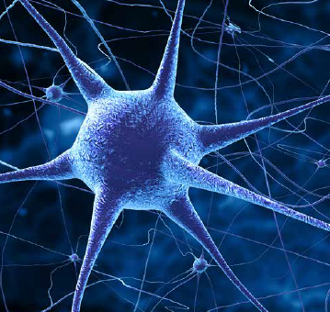
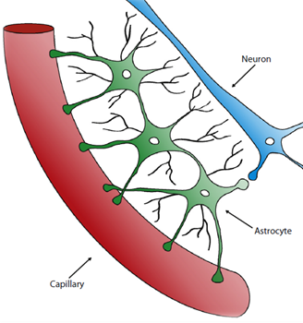
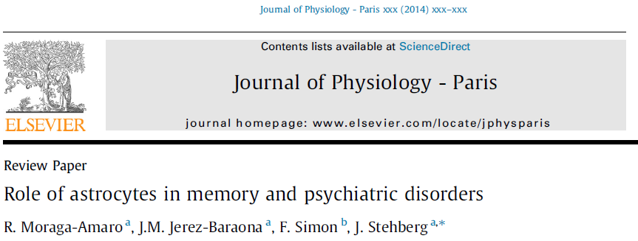
ASTROCYTES: A NOVEL TARGET FOR ANTIDEPRESSANTS
Astrocytes release neurotransmitters into synapses that activate neurons.
Decreased release from astrocytes results in reduced neuron-to-neuron synaptic activity.
Aleph Pharma/UNAB has demonstrated the ability to selectively reduce astroglial release of neurotransmitters resulting in a decrease in NMDAR activity and antidepressant effects
Aleph
Pharmaceuticals

Slide 6
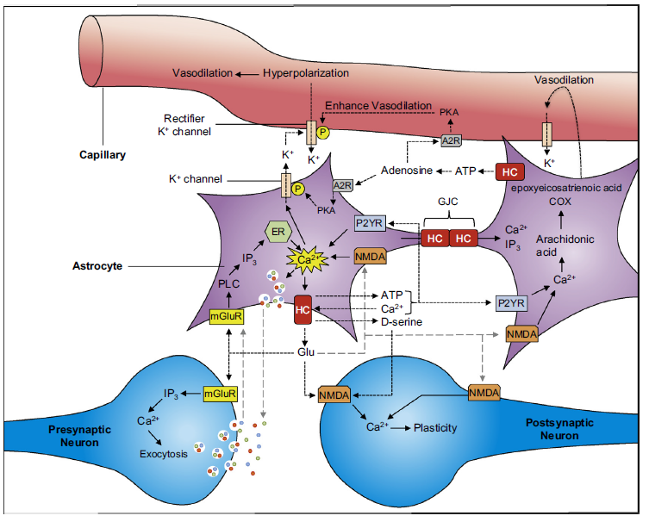

DECREASING NMDA-R ACTIVITY TROUGH ASTROCYTE MODULATION
Target: astrocytes connexin 43 hemichannels.
Purpose: Decrease the release of glutamate and D-serine which are necessary for NMDA receptor activity.
Result: less activity on NMDA-R, avoiding Ca+ release and increase of AMPA-R and Na+. (NMDA-R responds to glutamate in presence of D-Serine as coagonist).
Ketamine: blocks NMDA-R and induces antidepressants effects with many side effects.
Blocking astroglial conexin 43 hemichannels has similar antidepressants effects by decreasing NMDA-R activation rather than blocking it.
Ketamine blocks completely NMDARs inducing sedative effects.
X
New Drug
X
Ketamine
To-date, we have demonstrated antidepressant activity in animals for new drug, without sedative effects or death at clinically relevant doses.

Slide 7
Astroglial cX43 hemichannels and depression
MDD patients and animal models for depression show an increase in Cx43 HC activity in depression relevant brain regions
Orellana et al., 2015; Miguel-Hidalgo et al., 2014
Antidepressants decrease Cx43 HC activity in astrocytes
Jeanson et al., 2016
Cx43 KO mice show a reduction of depression-related behaviors
Quesseveur et al., 2015.
Aleph
Pharmaceuticals

Slide 8
BLOCKING Astroglial cX43 hemichannels
DECREASES NMDAR ACTIVITY IN NEURONS AND HAS ANTIDEPRESSANT EFFECTS
TAT-Cx43L2 (TAT-L2) is a mimetic peptide that blocks Cx43 hemichannels without affecting Cx43 gap junctions. (A) When injected into the hippocampus, TAT-L2 induces antidepressant effects (measured using the FST in rats that underwent chronic restraint stress), which can be prevented by co-infusion with glutamate and D-serine. (B) When hipocampal slices are incubated with TAT-Cx43L2, NMDAR activity is reduced, effect that can be prevented by addition of glutamate and D-serine. TAT-L2 has no effects on NMDAR activity in hipocampal neuronal cultures void of astrocytes.
Aleph
Pharmaceuticals

Slide 9
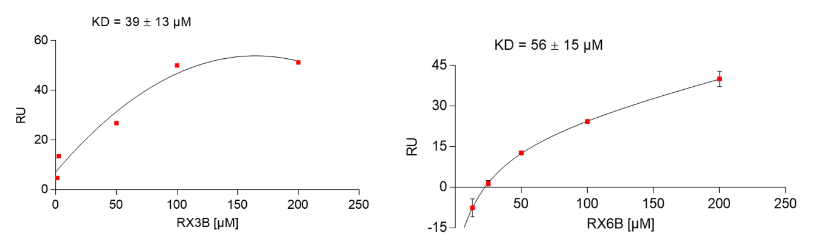
RX3B BINDS TO THE TARGET PROTEIN AND HAS EFFECTS IN VITRO AT nM RANGE
Interacts with the target protein with a KD of 30-60 µM
Measured using plasmon resonance
IC50 in transferected HeLa cells at nM range
Measured using dye uptake
IC50 in astrocytes ⁓50 nM
Measured using dye uptake
RX3B
Aleph
Pharmaceuticals

Slide 10
ANTIDEPRESSANT EFFECTS OF RX3B
IN VIVO
Shows antidepressant-like effects when injected systemically (s.c) at a 13 µg/Kg dose .
Measured in FST on animals that underwent chronic restraint stress.
15 mg/Kg
13 µg/Kg
Shows antidepressant effects similar to ketamine when injected systemically
Measured in TST on animals that underwent chronic restraint stress.
Aleph
Pharmaceuticals

Slide 11
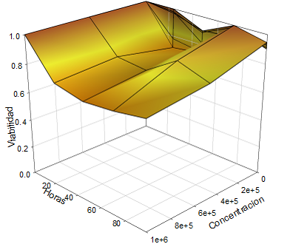
Side of effects of our lead compound
Low celular toxicity (viability assay using MTT of transfected HeLa cells)
No sedative effects. No reduction in locomotion in the open field. No noticeable behavioral abnormalities.
Low toxicity (LD50˃ 325 mg/kg), high oral absorption (95%)
Obtained module QikProp of the Suite Maestro of Schrödinger
No toxicity on organ function after single dose on analytes implicated in renal function (Blood uric nitrogen (BUN), Creatinin, Uric acid, Calcium) and hepatic function (total Billirubin; blood transaminases (ALT, AST, GGT) and phosphatases (ALP))
Obtained using Piccolo, blood biochemical assay, n=3.
Aleph
Pharmaceuticals

Slide 12
Competition
Drug | Time to attain effects | Novelty of target | Side effects
Serotonin transporter (SSRIs) | 3-4 weeks | Not novel | Low
Cyclic antidepressants | 3-4 weeks | Not novel | High
Monoamine oxidase inhibitors (MAOIs) | 3-4 weeks | Not novel | High
Ketamine | ˂1 hour | Not novel | High*
Esketamine (Spravato) | ˂1 hour | Not novel | Medium*
RX3B | ˂1 hour | Novel | Low
* Requires treatment performed by a doctor
Aleph
Pharmaceuticals

Slide 13
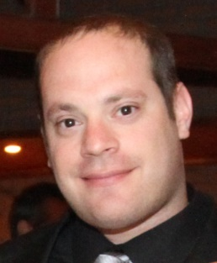








An international Scientific
& Business Team
Investigators:
Dr. Jimmy Stehberg (in vitro, in vivo models).
Dr. Felipe Simon (in vitro screening).
Dr. Danilo González (In sillico work; small molecules).
Outside collaborators:
Fraunhofer IME, Germany.
UGhent, Belgium (Luc Leybaert).
KULeuven, Belgium (Geert Butynck).
UDD, Chile, (Mauricio Retamal).
Advisors:
Nancy Levy
Francisco Chiang
Amanda Wagner
Aleph
Pharmaceuticals

Slide 14
EXECUTIVE SUMMARY
Technology | Novel small molecule antidepressants targeting astrocytes
Novel cell target | First known compounds to target brain astrocytes, a cell type that participates in neuronal synapse signaling
Validated mechanism of action | By targeting Cx43 hemichannel-mediated astroglial release of D-serine and glutamate, the activity of NMDA receptors is diminished, inducing antidepressant effects like KETAMINE, but without its sedative effects.
Lead candidate with fast antidepressant effects in rodents | Lead compound with rapid (˂10 min) antidepressant effects when administered systemically in rats
Issued intellectual property | Patent granted (WO2013179264A) in US. Additional follow-on compounds in drafting.
Financing to-date | $600K Competitive Grants. $50K private investment.
Team | Expertise in drug discovery, in vitro and in vivo assays
Aleph
Pharmaceuticals

Slide 15
Astrodepressants
Antidepressants Targeting Astrocytes
Dr. Jimmy Stehberg
jstehberg@unab.cl
Conclusion: Aleph Pharma/UNAB is seeking a partner to collaborate/ finance IND-enabling toxicology and/or in-license our novel molecules
Aleph
Pharmaceuticals

Slide 16
Annexes
Aleph
Pharmaceuticals

Slide 17
What we know about chronic stress in the glutamatergic synapse
Olijslagers et al., 2008
Musazzi et al., 2010
Fontella et al., 2004
Armario et al., 2008.
Presynaptic release of glutamate
P₂X₇
Panx1
Chronic
stress
Astroglial calcium waves
Orellana et al., 2015
ATP
Glu
D-Ser
Cx43
HC
Excitotoxicity
GLUT
NMDAR
Pan et al., 2015
Meunier et al., 2017
Miguel-Hidalgo et al., 2014
Shin and Liberzon, 2010
de Vasconcellos-Bittencourt et al., 2011
Persson and Ronnback, 2012
Theodosis et al., 2008
Cx43
Decreased gap junctional
communication
Bernard et al., 2011
Ernst et al., 2011
Sun et al., 2012
Miguel-Hidalgo et al., 2014
Aleph
Pharmaceuticals

Slide 18
Timeline
GMP
Preliminary
safety study
In humans
GLP, preclinical
Oral formulation
FDA (IND
Application)
Phase I
US
2 year
6 months
3 months
1 year
2018
2020
2021
2022
Aleph
Pharmaceuticals

Slide 19

Traction
Funding: $700K in non-dilutive grants.
We have published 7 papers on the role of our target in psychiatric disorders, including depression, anxiety and memory.
We have setup active collaborations on this topic with several labs in Chile, Belgium, Germany and France.
*US patent granted on a small molecule for use in depression: US 14/404.358 "Use of compounds that selectively modulate astrocytic release of substances…”
Aleph
Pharmaceuticals

Slide 20
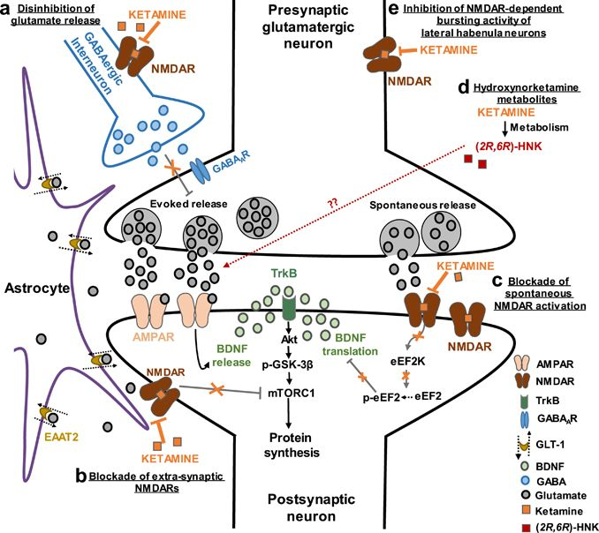
Zanos & Gould 2018
Aleph
Pharmaceuticals

