Slide 1
BioGellics
Salvador Borrós Gómez
5th December 2019
Salvador.borros@iqs.url.edu

Slide 2
BIOGELICS

Slide 3
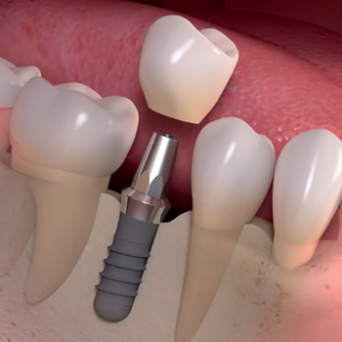
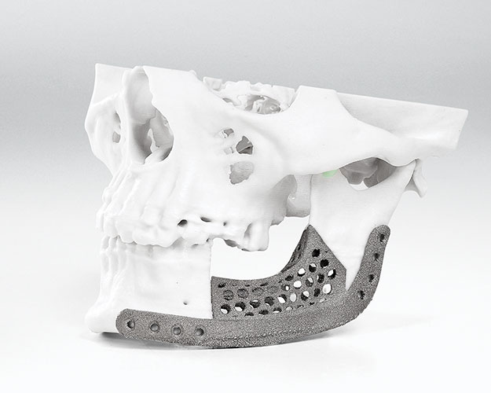
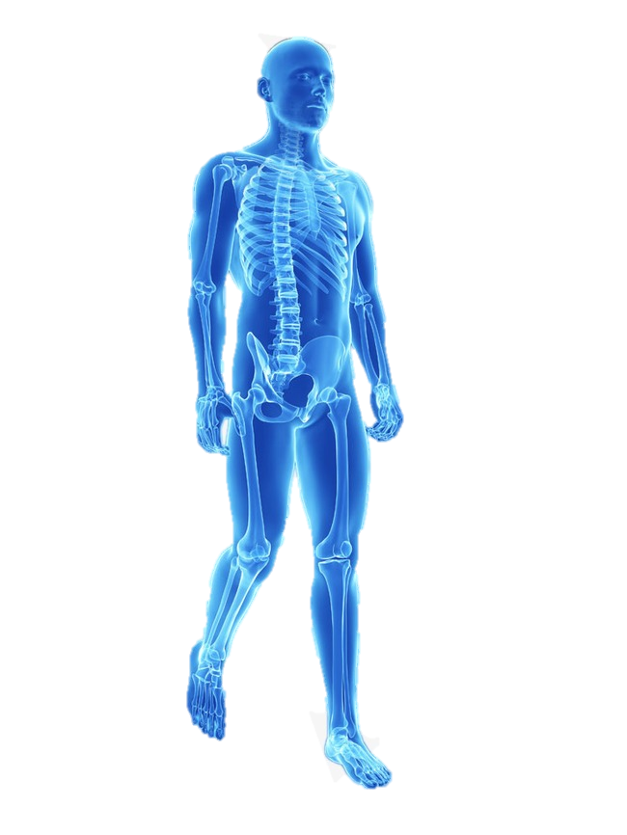
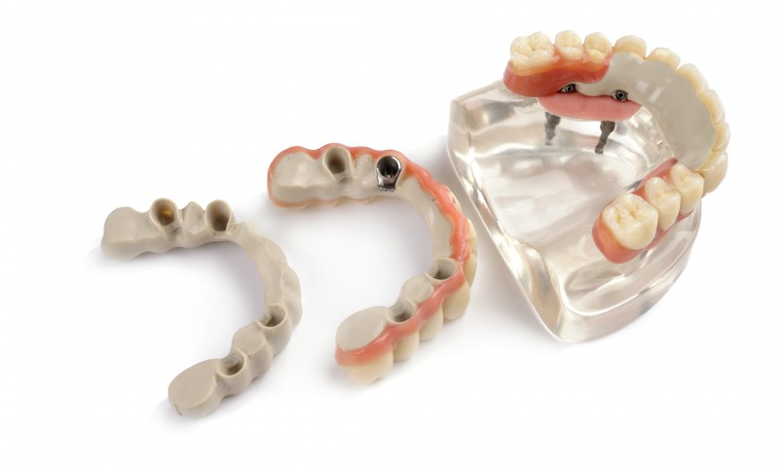
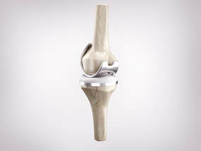
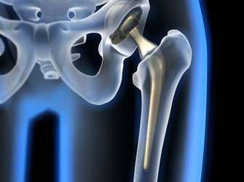
The problem
Dental implants
Jaw reconstruction
Hip implants
Knee implants
LACK OF TISSUE INTEGRATION OF IMPLANTABLE MATERIALS
Notes:
The problema and who has it

Slide 4
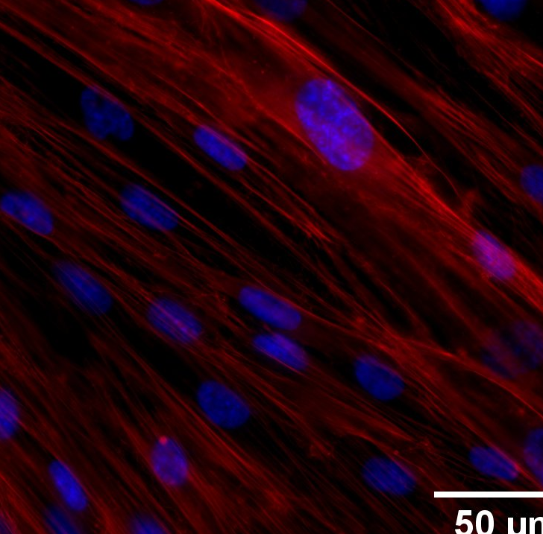
Our solution
Coating technology that enhances tissue integration
Versatile
Applicable to a wide range of materials
Bioactive
Surface engineering
Tunable cell response
Biomimetic
ECM-like collagen-based hydrogel coating.
Notes:
The solution and value proposition
- Why the product solves the problem far better than anything else
How is your product going to improve the world by fixing this problem.
Demonstration of the product ➔ visual information

Slide 5
WHAT WE HAVE ACHIEVED
Biomimetic Collagen-based hydrogel attached onto a bone-like bioceramic
No discontinuity through the scaffold
Hydrogel composition tailored layer by layer
Higher mechanical stability

Slide 6
WHAT WE HAVE ACHIEVED
Biomimetic Collagen-based hydrogel attached onto a bone-like bioceramic
European Patent Application EP 18382929.0
PCT to be presented at the end of the year
National Phases after 18 month included USA, Japan Australia and China

Slide 7
Biogellics Pipeline
Coating technology that enhances tissue integration
Osteochondral scaffold
PEEK-based dental guides
Technology validation

Slide 8
Business model
Dental
SELL
Medical device companies
2 products
Development
Hospitals
Company
Osteochondral scaffold
Coating technology
License agreements

Slide 9
Canvas
Key Partners
Key Activities
Value Proposition
Customer Relationships
Customer Segments
Hospitals
R&D
Coating technology to increase tissue integration (TI)
Conferences and congress
Rheumatologists
Industrial partners
Financing
Orthopedic surgeons
Regulatory strategy
Publications
Public/Private healthcare centers
Pharma companies
IP strategy
Social networks
Improved patients’ quality of life
Web
Patients
Medical device companies
Tech and R&D centers
Key Resources
Minimized risk of implant failure
Channels
Minimized need of reintervention
Meetings
Human resources
Conferences
Know-how
Distributors
IP
Cost Structure
Revenue Streams
R&D
Direct sales
Infrastructure
Licensing
Materials
Regulatory

Slide 10
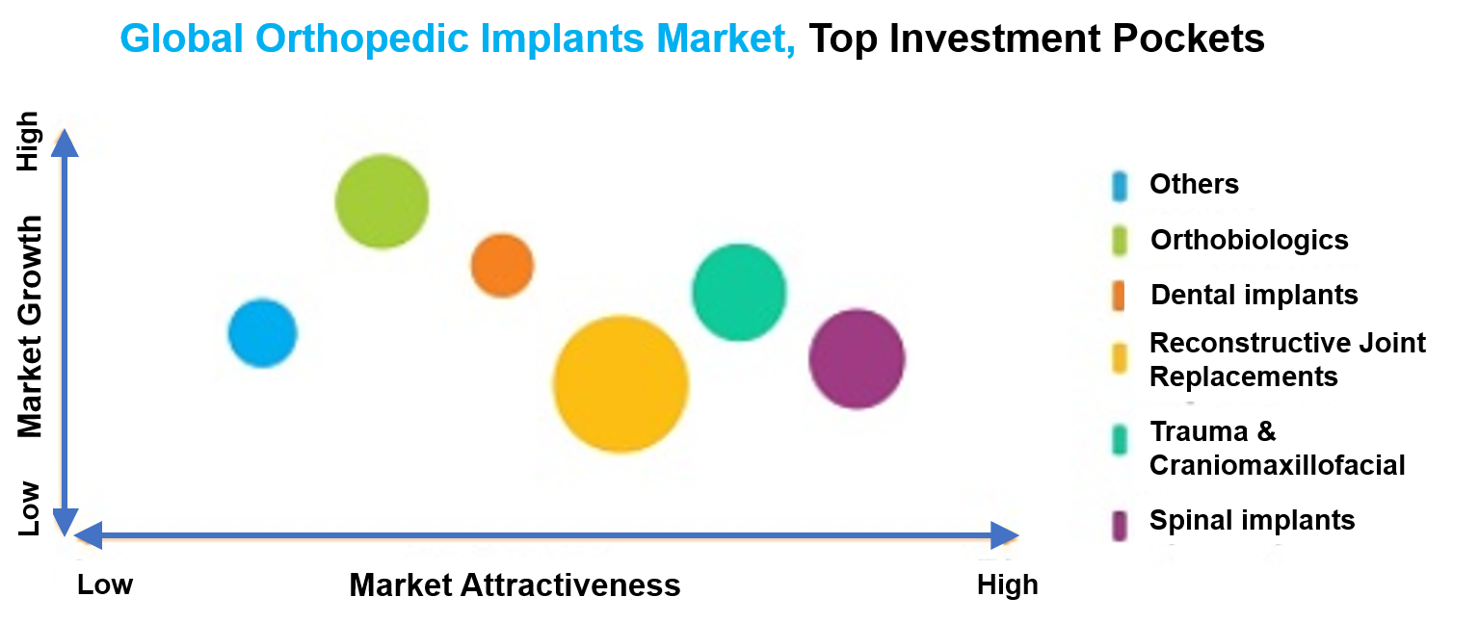
The market: Global orthopedic implants market
Adapted from: Global Orthopedic Implants Market. Opportunities and Forecasts 2017-2023. Allied Market Research.

Slide 11
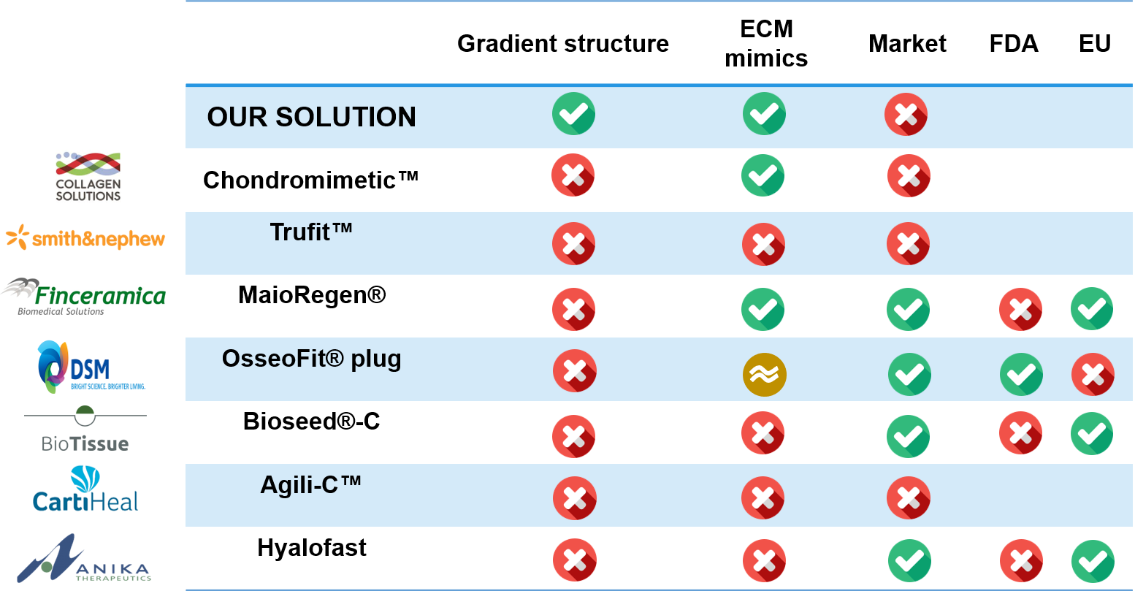
Our competitors: Osteochondral repair

Slide 12
Partnership and collaborations
Potential Industrial Partner
Potential Industrial Partner
PEEK-OPTIMA™ with 15 years of clinical history.
Chondroitin sulfate & hyaluronic acid manufacturer
Arthrosis drugs portfolio
Focused R&D on cartilage repair
Medical Partner
Experience working with PEEK implants and prostheses

Slide 13
PoC: PEEK
Available strategies
Our Solution
Plasma treatments to increase wettability
Tunable
Bioactive surface
Nano-structured coatings
ECM mimics both
chemically
physically
Bioactive coatings such as nano-hydroxyapatite
Induce a desired cell response
Good bone-tissue interface
Aggressive coating methods that can damage PEEK structure
Provide a good anchoring to the gums

Slide 14
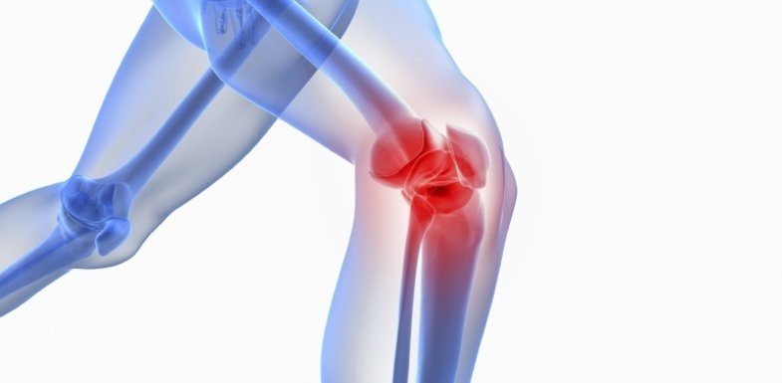
PoC: Osteochondral scaffold
Osteoarthritis (OA)
240 M
affected people¹
OA
Surgery
Knee OA
affects
for end-stage knee OA
is performed on
contributes > than
80%
658,000
$27 bn
people > 65 years in developed countries
Americans / year²
/ year healthcare costs³
¹OAFI Foundation
²Bhandari M, et al. Clinical and Economic Burden of Revision Knee Arthroplasty. Clin Med Insights Arthritis Musculoskeletal Disord. 2012.
³Losina E, et al. Lifetime Medical Costs of Knee Osteoarthritis Management in the United States: Impact of Extending Indications for Total Knee Arthroplasty. Arthritis Care Res (Hoboken). 2015; 67: 203-215.

Slide 15
Hurdless
Too Risky
Regulatory Changes in the next years
Investing
Need for a Strong Team (we have improved since October)

Slide 16
Our Development
OSTEOCHONDRAL SCAFFOLD
 | 2016 |  |  |  | 2017 |  |  |  | 2018 |  |  |  | 2019 |  |  |  | 2020 |  |  |  | 2021 |  |  |  | 2022 |  |  |  | 2023
Development
Experimental testing
Pre-prototype
Prototype
Scalability
Manufacturing
In vivo pilot
Regulatory Strategy
Preclinical
Clinical
CE marking

Slide 17
Technology development
PEEK-BASED DENTAL IMPLANTS
 | 2016 |  |  |  | 2017 |  |  |  | 2018 |  |  |  | 2019 |  |  |  | 2020 |  |  |  | 2021
Development
Experimental testing
Pre-prototype
Prototype
Scalability
Manufacturing
In vivo pilot
Regulatory Strategy
Preclinical
CE marking

Slide 18
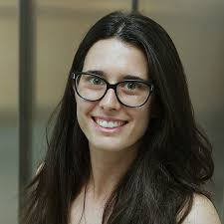
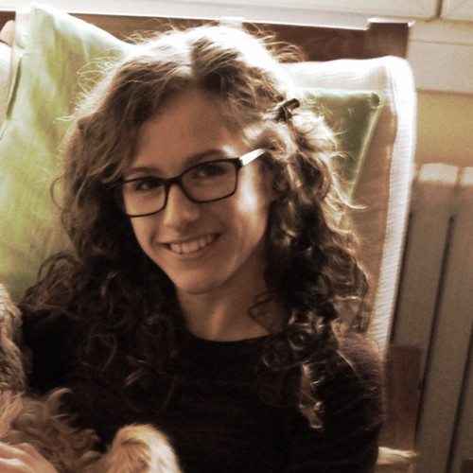
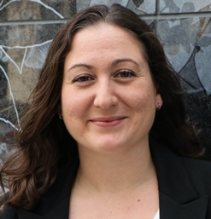
The team
Salvador Borrós Gómez
IQS Engineer, PhD, Full Professor at IQS, IP and Scientific Leader of GEMAT.
16 patents and 157 publications. 31 PhD thesis supervised, 8 in active and more tan 100 master thesis supervised.
Projects: 7 EU Projects and 10 National Projects as IP
Awards: Talgo Award to the Innovación Tecnológica 2002; Bioentrepreneurs XXI Award (2009) to Best Business Plan for Sagetis Biotech; Premi Innovació Col·legi d’Enginyers Industrial de Catalunya, 2011.
Co-founder and CSO of Tractivus, Sagetis Biotech, Aortyx and Sailing Technologies, Co-founder of Flubetech and Khalkos.
Anna Mas Vinyals
Chemical Engineer (IQS), MSc., PhD in Bioengineering, CIMTI Project Manager
1 publication.
Postgraduate in Innovation and R&D Project Management, UOC
Winner of Pare Salvador Gil SJ Award for the Best Master Thesis in Bioengineering (2015)
Board Member of Alumni Association of IQS (AIQS) (2016 – now)
Member of the Research Ethics Committee of Research of Universitat Ramon Llull (URL) (2016 – December 2018)
URL Student Council, IQS Academic Board Representative. (2016 – December 2018)
Laura Figueras Esteve
Biotechnologist (IQS), MSc. (IQS)
1 publication
Member of Associació de Biotecnolegs de Catalunya (ASBTEC) 2014-2017
April M. Craft, PhD
Assistant Professor of Orthopaedic Surgery at Boston Children’s Hospital and Harvard Medical School
2 patents and 10 publications.
Wide experience on cartilage development biology and development of therapeutics for disease attenuation and tissue regeneration and repair.

Slide 19
Round
1st Milestone
2016 | 2017 | 2018 | 2019 | 2020 | 2021 | 2022 | 2023 | 2024
Development
2nd Milestone
Experimental testing
Pre-prototype
Prototype
Scalability
Pre-clinical
Manufacturing
Clinical
CE mark
In vivo pilot (n=12)
validation
Regulatory Strategy
1st Milestone: PoC
2nd Milestone: Fabrication + Preclinical
Pre-prototype
430.000€
Scalability
Prototype
Detailed Design Specification
Design validation including a first in vivo approach (n=4)
Manufacturing (GMP)
In vivo pilot (n=12)
Preclinical
1’4M€
Regulatory strategy

Slide 20
Budget allocation
2019
2020
2021
424.250€
719.200€
671.200€
Prototyping
Scalability & Manufacturing
Validation ISO13485
Implementation ISO13485
Validation ISO13485
Preclinical evaluation
Initial EP Submission
PCT submission
Regulatory strategy development
Preclinical evaluation

Slide 21
Exit Strategy
2019
2020
2021
424.250€
719.200€
671.200€
INDUSTRIAL PARTNER FOR COMMERCIALITATION
LICENSE AGREEMENT WITH MILESTONES PAYMENTS

Slide 22
IDEA2
Preparation of new bussiness Canvas (presented before)
Strength the networking with Dental Clinics in Catalonia
New proof of concept on PEEK materials
Active looking for seed funding. Two accelerators interested
Redesigning the team. New CEO found
New leadership
Allocate the project as a research project to be developed using public funding

Slide 23
IDEA2
People we have spoken
Patricia Burés: Business consultant
Raül Zurita: Investment consultant
Carlos Bel: Team building consultant
Oriol Cantó: Dentist
Joan Carbonell Dentist
Jordi Amat: Dentist

Slide 24
BioGellics
Salvador Borrós Gómez
18th October 2019
Salvador.borros@iqs.url.edu

