Slide 1
Hepatic Encephalopathy App for Liver Disease (HEALD)
A Passive Monitoring Tool to Prevent HE Readmissions for Patients with Cirrhosis
December 5th, 2019, Idea² Global Commencement
Xing Li, MD, MBA
Thomas Wang, MD
Department of Internal Medicine, Hepatology and Liver Center
Massachusetts General Hospital, Boston, MA

Slide 2
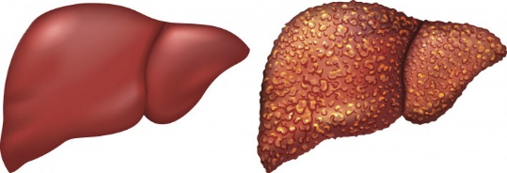
Hepatic encephalopathy (HE) is a highly prevalent, disabling and costly problem in the US
HE is neurocognitive decline resulting from liver dysfunction
600K people with cirrhosis in the US; 70% will develop HE
>115K admissions per year due to HE¹
>$7 billion healthcare charges¹
1. Stephanova M., Mishra A., Venkatesan, C., et al. In-hospital mortality and economic burden associated with hepatic encephalopathy in the United States from 2005 to 2009. Clinical Gastroenterology and Hepatology. 2012; 10(9): 1034-41.
Notes:
2045 million costs nationwide in 2009

Slide 3
The average HE patient journey – meet Joe who is 48 and has cirrhosis
Seen in liver clinic doing better
Meds decreased
Self-stopped meds due to side effects
Started to become more confused
Seen in clinic but due to severity of HE, sent to ED
Hospitalized for 1 week for HE
Discharged with meds
With proper monitoring, re-admission is preventable
Hospitalized for 5 days for HE
Discharged with additional meds

Slide 4
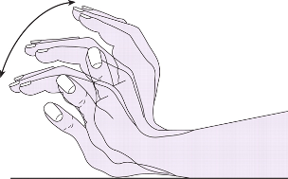
HE is slow and progressive, but can be reversible if caught and treated early
Home
Hospital
Hospital +/- ICU
Coma
~46,000 preventable HE-related hospital re-admissions occur per year costing the healthcare system ~$2 billion, mostly from delayed recognition. There is a clear unmet need to catch HE flares early.
OUR FOCUS
Time
Covert
Overt
Stages
Minimal
1
2
3
4
No visible symptoms
Attention and sleep disturbances
Confusion, slow speech, tremors
Marked confusion and somnolence
Complete unresponsiveness

Slide 5
Outpatient monitoring and medication titration can lead to fewer re-admissions and improve patient outcomes
Intended benefits
Side effects
Notes:
Medications can improve symptoms, but side effects limit adherence
Medications can be titrated from once a day to once every hour
Finding the optimal medication dose is a dynamic process, but difficult for providers who see patients every few months ---> therefore need for a good way to closely monitor these patients

Slide 6
Currently there is a not a way to practically monitor patient symptoms to prevent hospital re-admissions
Current clinical practice for HE
Diagnostics for early HE limited
Other budding tools
Notes:
Current:
Relies on patient or family recognition of confusion (which can be highly variable)
Once a patient presents to clinic, often the diagnosis is already delayed, leading to hospitalization
Other tools:
EncephalApp, based on the Stroop test, validated to diagnose covert HE, but not for monitoring purposes
Takes 15 – 20 min to complete, boring, difficult for patients to adhere routinely
Diagnostics:
Not detected based on clinical symptoms
Gold standard currently is psychometric testing (PHES)
Time-intensive, needs supervision, mostly for research settings

Slide 7
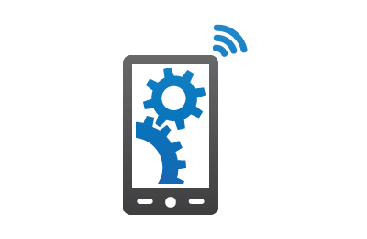
We propose an app-linked wristwatch tool to monitor progression of HE at home and catch flares early
Tracks sleep and movement patterns
Utilizes machine-learning algorithm to predict worsening of HE and alert clinicians and patients/families
Passive monitoring by wearing the device
Notes:
Quantity and quality
Been studied for other movement disorders such as PD and AD

Slide 8
The app will allow patients to visualize trend of HE, and will trigger alerts to providers to prompt intervention
Patient/Caretaker
Provider (MD, RN)
Daily summary of sleep and movement data
Daily summary of sleep and movement data
Trend of HE progression
Trend of HE progression
Alert to notify provider
Alert to prompt outreach/action

Slide 9
We conducted clinician interviews, patient surveys and chart reviews to validate our unmet need
Clinician interviews: Interviewed a dozen clinicians, who uniformly recognized unmet need, and thought idea was likely clinically impactful in improving outcomes and reducing readmissions
Patient surveys: surveyed 50 patients with cirrhosis, 64% already utilize smartphone to manage disease
Chart reviews: reviewed 50 patients admitted to MGH within 3 months for HE, about 40% preventable

Slide 10
Short-term strategy
Apply for grants: Institutional and society grants
Design and Conduct Pilot study:
Proof-of-concept study for small number of patients
Apple iWatch with ResearchKit platform
File intellectual property
Develop commercial strategy

Slide 11
Team
Cofounders:
Thomas Wang, MD – clinician, expertise in research design/implementation and innovative technology
Xing Li, MD, MBA – clinician, business and financial strategy
Current advisors:
Jason Tucker–Schwartz – strategy, idea² advisor
Claire Zhao – machine-learning, idea² advisor
Raymond Chung, MD – clinical, MGH liver department chair
Nneka Ufere, MD – clinical, MGH liver fellow
Notes:
PRELIMIARY MARKET SIZE
COMPETITOR ANALYSIS
POTENTIAL REVENUE – TARGET ACO (RISK-CONTRACTED), SUBSCRIPTION MODEL

Slide 12
Hepatic Encephalopathy App for Liver Disease (HEALD)
A Passive Monitoring Tool to Prevent HE Readmissions for Patients with Cirrhosis
Thank you for listening!
Xing Li, MD, MBA, xli70@partners.org
Thomas Wang, MD, twang16@partners.og

