Slide 1
IMPROVING IMMUNO-ONCOLOGY
FOR COLORECTAL CANCER
John Priatel, Ph.D., Founder
IDEA² Global Commencement Workshop, MIT
December 5-6th, 2019
Notes:
MAKING COLON CANCER RESPONSIVE TO IMMUNO-ONCOLOGY (IO)
Cancer immunotherapy, or immuno-oncology, has revolutionized cancer treatment and saved patients thought to be terminally ill. However, like many solid cancers, IO is not effective for most patients with colon cancer. We are working on a drug to make colon cancers responsive to IO therapy

Slide 2
Current IO drugs have shown tremendous potential but fail in most tumor types
The problem
Approved immunotherapy drugs have achieved unprecedented efficacy for some patients
Many patient and tumor types do not respond to existing IO
T cell
Certain cells in the tumor microenvironment suppress the function of cancer-killing T cell
Current IO boosts the function of cancer killing T cells
MDSC
T cell
T cell
MDSC
Example of immunosuppressive
cell type
DC
T cell
DC
T cells eliminate tumor cells
Tumor cells
Kalbasi et al. J. Clin. Invest. 123: 2756–2763.
Tumor cells
Notes:
Immunosuppressive regulatory T (T_{Reg}) cells and myeloid-derived suppressor cells (MDSCs) secrete numerous tolerogenic cytokines, such as interleukin-10 (IL-10) and transforming growth factor-β (TGFβ), which thereby inhibits anti-tumour immune responses. Strategies to inhibit immunosuppressive cytokine secretion or to kill T_{Reg} cells and MDSCs (inhibitory arrows) diminish immune suppression and promote T cell-mediated tumour destruction.
Most patients experience resistance to current IO drugs due to immune suppression by other mechanisms

Slide 3
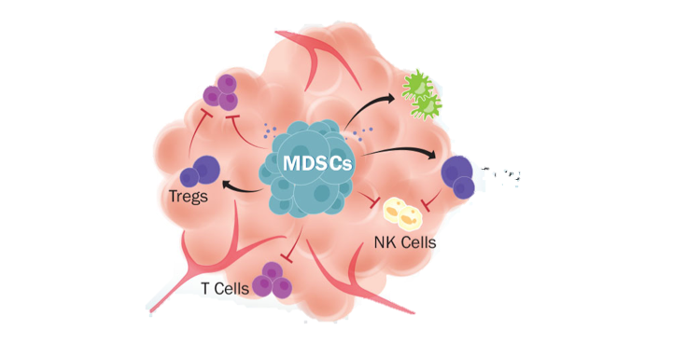
Improving IO therapy by knocking down myeloid-derived suppressor cells (MDSCs)
The solution
Current IO to stimulate T cells
Inhibit the action of
immuno-suppressive cells
CD8 T cells
Tregs
Synergistic mechanisms between current IO drugs and newly discovered drugs
Notes:
Immuno-Oncology has focused on enhancing the function of immune cells called T cells to kill cancer cells through drugs called checkpoint inhibitors. However, many cancers fail to respond to checkpoint inhibitors likely because other immunosuppressive pathways are engaged. ME was founded with the purpose of developing 2nd gen drugs on the belief that combination IO therapy will be required to overcome cancer resistance to IO monotherapy.. Our lead drug targets G-CSF which is a key player in immune suppression by cancer cells. G-CSF is a produced by a number of cancer types, especially CRC, and acts as a growth factor for immunosuppressive myeloid cells.

Slide 4
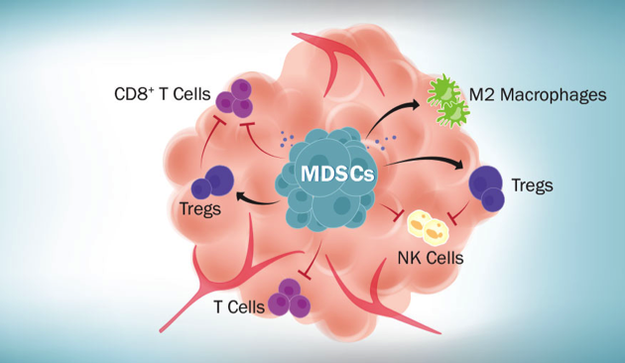
Our Approach: Targeting myeloid cells by neutralizing G-CSF to improve anti-cancer immune responses
The product
G-CSF function: expands immunosuppressive myeloid cells
Step 2: Decreased number and function of MDSC cells
Step 1: Drug that neutralizes G-CSF
1
2
3
G-CSF
Evidence that G-CSF:
Creates a suppressive tumor environment
Strongly associated with poor survival
MDSC
Step 3: Enhanced T cell activity
Notes:
Immuno-Oncology has focused on enhancing the function of immune cells called T cells to kill cancer cells through drugs called checkpoint inhibitors. However, many cancers fail to respond to checkpoint inhibitors likely because other immunosuppressive pathways are engaged. ME was founded with the purpose of developing 2nd gen drugs on the belief that combination IO therapy will be required to overcome cancer resistance to IO monotherapy.. Our lead drug targets G-CSF which is a key player in immune suppression by cancer cells. G-CSF is a produced by a number of cancer types, especially CRC, and acts as a growth factor for immunosuppressive myeloid cells.

Slide 5
Our First Application: COLORECTAL CANCER
High Unmet Medical Need
Evidence that Our Target plays a role in CRC
G-CSF is highly expressed in many colorectal cancers and creates an immunosuppressive tumor microenvironment
3rd most common cancer type in the US
Metastatic CRC - 5 year survival rate ~14%, and there are no curative therapies
IO effective in only about 5% of CRC cases
G-CSF Disease Survival in CRC
Notes:
Colorectal cancer is the third most common cancer type in the U.S. and the second most deadly. Globally, there are approximately 1.8 million cases of colorectal cancer diagnosed each year, along with over 900,000 deaths caused by the disease.
(1) Colorectal cancer has a high incidence world-wide
(2) Metastatic CRC has a poor 5-year survival rate
(3) IO is not effective against metastatic CRC

Slide 6
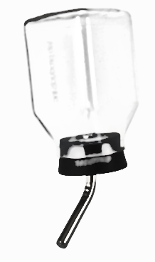
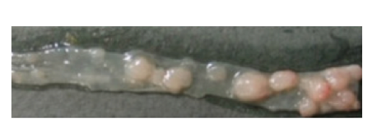
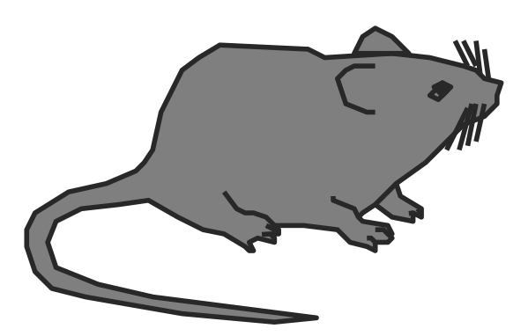

TECHNOLOGY: Anti-G-CSF Biologic
Overcoming G-CSF-induced immune suppression
Colorectal cancer model
AOM/DSS
Reduces colonic MDSCs and increases CD8 T cells
Decreases tumor counts
Our biologic is ready to test alone or in combination with current IO to empower IO to cure CRC patients

Slide 7
THE COMPETITION
Current targets not effective in CRC
Crowded Pipeline
IO drugs
  Keytruda or Opdivo (approved for only 5% of patients with MSI high tumors)
Drugs under development
  Growth factor receptor targeting drugs (similar to Cetuximab and Bevacizumab)
  CSFR targeting drugs in combo with Keytruda/Opdivo (IO) – Limited efficacy so far
ME Therapeutics is pursuing a unique approach
Only company going after G-CSF blockade
Notes:
Focus on our expertise – Founders are experts in immunology and cancer. Over 80 pubs and patents and >2M in funding. What do we need? What are we planning to do? Ready to start IND enabling studies and toxicology prior to Phase I trial? GLP (good laboratory practices) manufacturing, to ensure the uniformity, consistency, reliability, reproducibility, quality, and integrity of chemical. Need to take to next step. Say about

Slide 8

THE COMPANY
Team, funding & support
  ME THERAPEUTICS INC. (Myeloid Enhancement Therapeutics) was founded in 2014
  by Dr. Salim Dhanji Ph.D. (CEO), Dr. John Priatel, Ph.D. and Dr. Ken Harder, Ph.D.
  Academic & industry experience with expertise in cancer, lymphocytes and cancer immunology and over 90 scientific publications and patents and >$2 million in funding
  Started from founder, friend and family investments and matching funds from The National Research Council-Industry Research Assistance Program (IRAP)
  Our team includes 2 full-time Ph.D. Scientists, uses space in The Life Sciences Centre at UBC and is a participant in Massachusetts Institute of Technology IDEA2 Startup Incubator Program
Notes:
Focus on our expertise – Founders are experts in immunology and cancer. Over 80 pubs and patents and >2M in funding. What do we need? What are we planning to do? Ready to start IND enabling studies and toxicology prior to Phase I trial? GLP (good laboratory practices) manufacturing, to ensure the uniformity, consistency, reliability, reproducibility, quality, and integrity of chemical. Need to take to next step. Say about

Slide 9
TRACTION & SUMMARY
Focused on improving patient outcomes in CRC
Strong literature supporting G-CSF as a potential target in colorectal cancer
Worldwide patents filed (composition and use) on 2 lead antibodies –100% IP owned by ME Therapeutics Inc.
Formed collaborations with BC Cancer Agency doctors for access to human specimens
Awarded commercialization grant from Michael Smith Foundation for
Health Research (Oct 2019) – validating science
We are seeking funds for advanced preclinical development of our drug to improve immuno-oncology response rates to colorectal cancer
Notes:
Several key publications demonstrate the importance of G-CSF as a target in CRC.
We have two high affinity neutralizing G-CSF antibodies that are fully humanized. Worldwide patents have now been filed and ME Therapeutics own 100% of the IP.
In addition, we are collaborating and have support from oncologists at British Columbia Cancer Agency
Our science has been validated by recent academic grant funding– Aims include generating a model to test our antibody, test efficacy of our antibody with checkpoint blockade, examine G-CSF expression in GI cancers and test our antibody with human GI cancer preclinical models.

Slide 10

CONTACT
Dr. Salim Dhanji, PhD, CEO and founder
Address
3540 – 2350 Health Sciences Mall
Vancouver, BC, Canada
V6T 1Z3
Contact Info
Email: salim@metherapeutics.com

