Slide 1
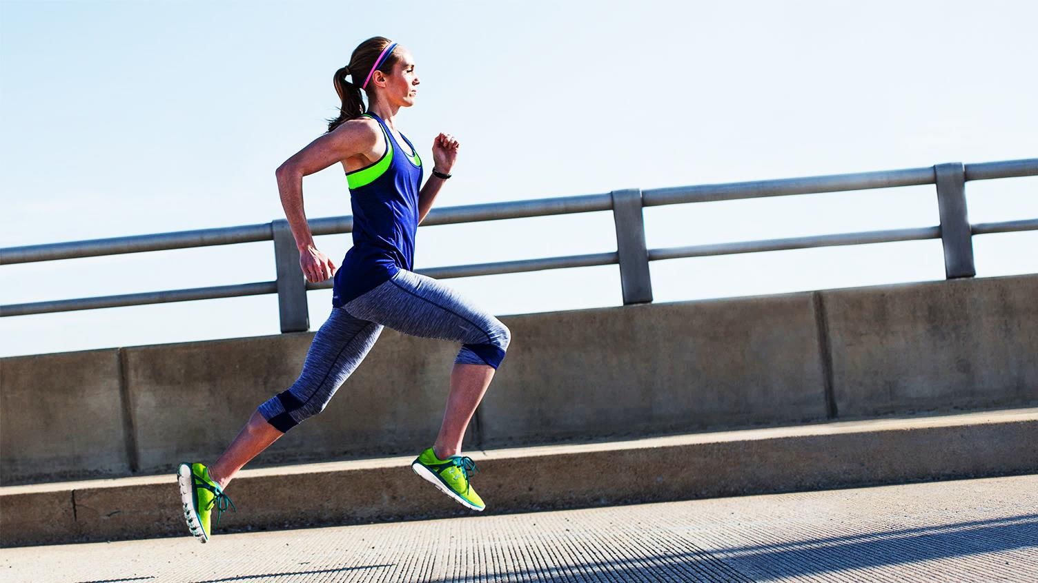
CHASKI™ wearable respiratory analysis for athletes
Boston, December 2019
Vader A. Johnson
Daniel E. Hurtado
vjohnson@icinnovations.cl
daniel@icinnovations.cl
Notes:
Hi Everyone, My Name is Vader Johnson and today I want to introduce you to Chaski,

Slide 2
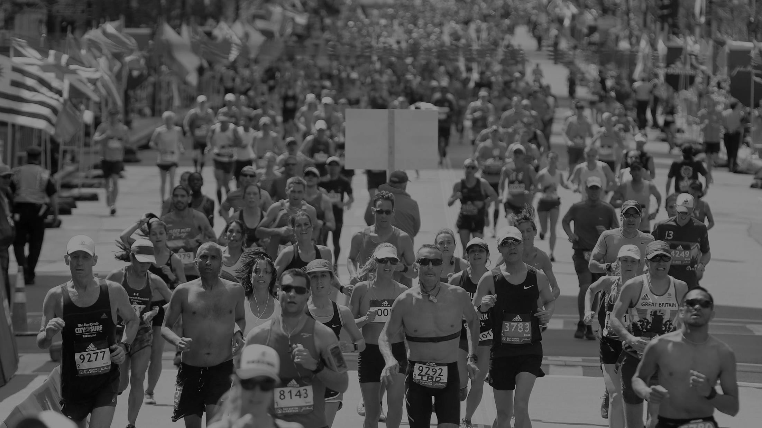
When competing, every second counts
2019. Boston Marathon
USA Men
7th
place
01:12
behind the winner
USA Women
3rd
place
01:49
behind the winner
Notes:
In the last Boston Marathon, the best American performers arrived in 3rd and 7th place,
Both more than one minute behind the winner.
In a competitive race like this, every second of improvement can make a huge difference
So what can runners do to improve their race times?
https://olympics.nbcsports.com/2019/04/15/2019-boston-marathon-results/

Slide 3
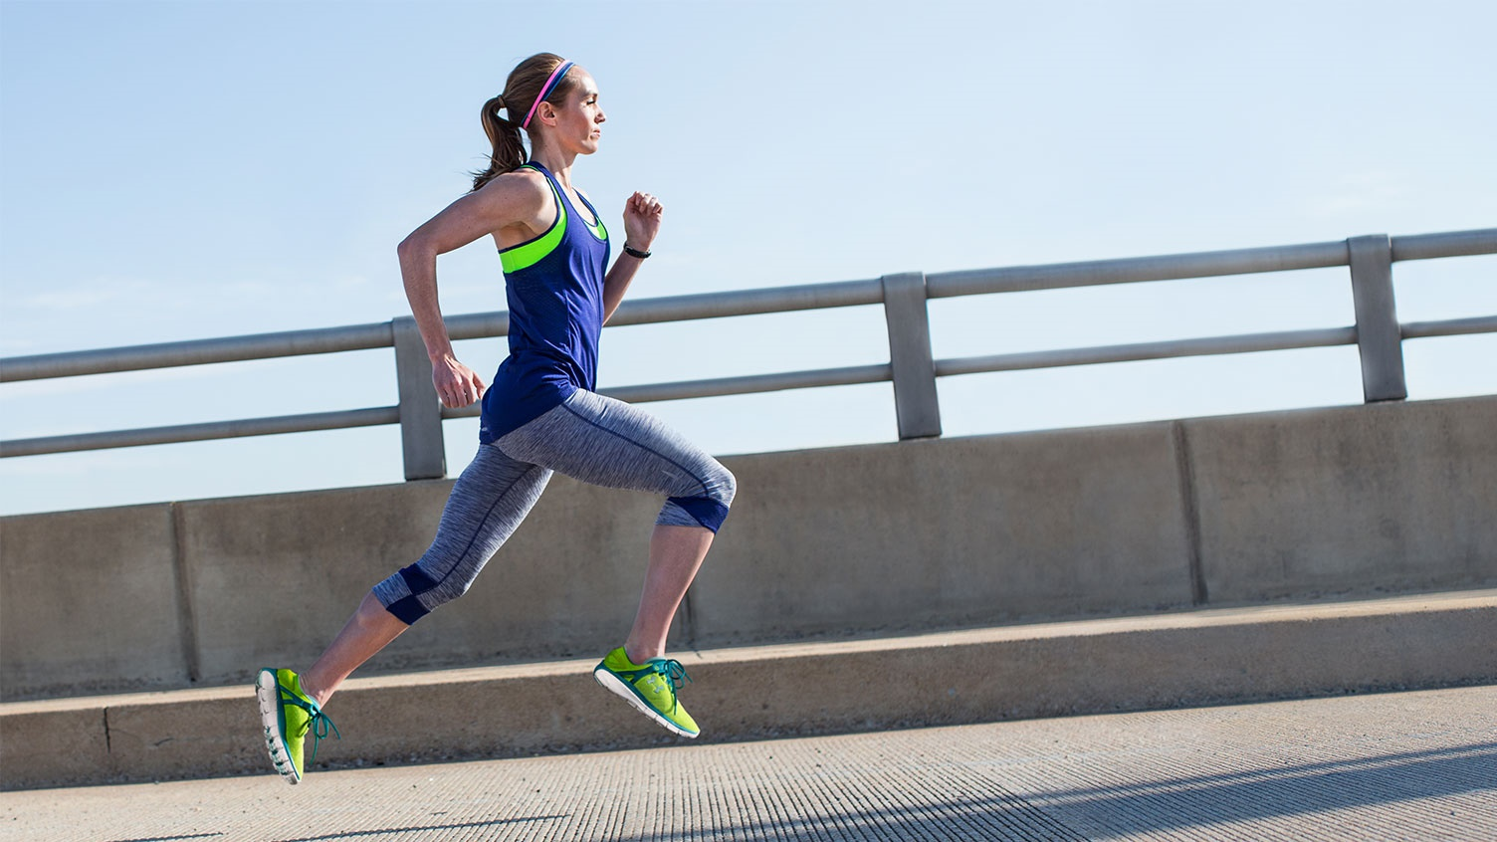
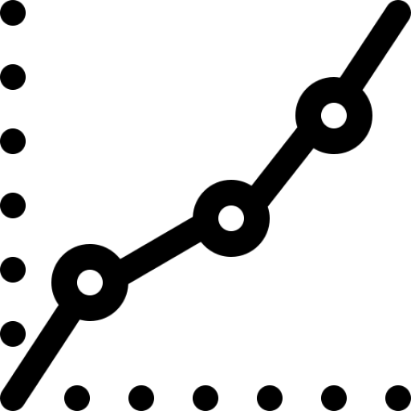
Endurance
Anaerobic Threshold
Push
harder!
Don’t burn out!
Notes:
When performing any kind of endurance sport, like running,
It is critical to keep balance between pushing harder, so you can beat you marks,
and at the same time avoid crossing the physical effort threshold that will make you burn out.
Training around this “sweet spot” is the key to improve performance

Slide 4
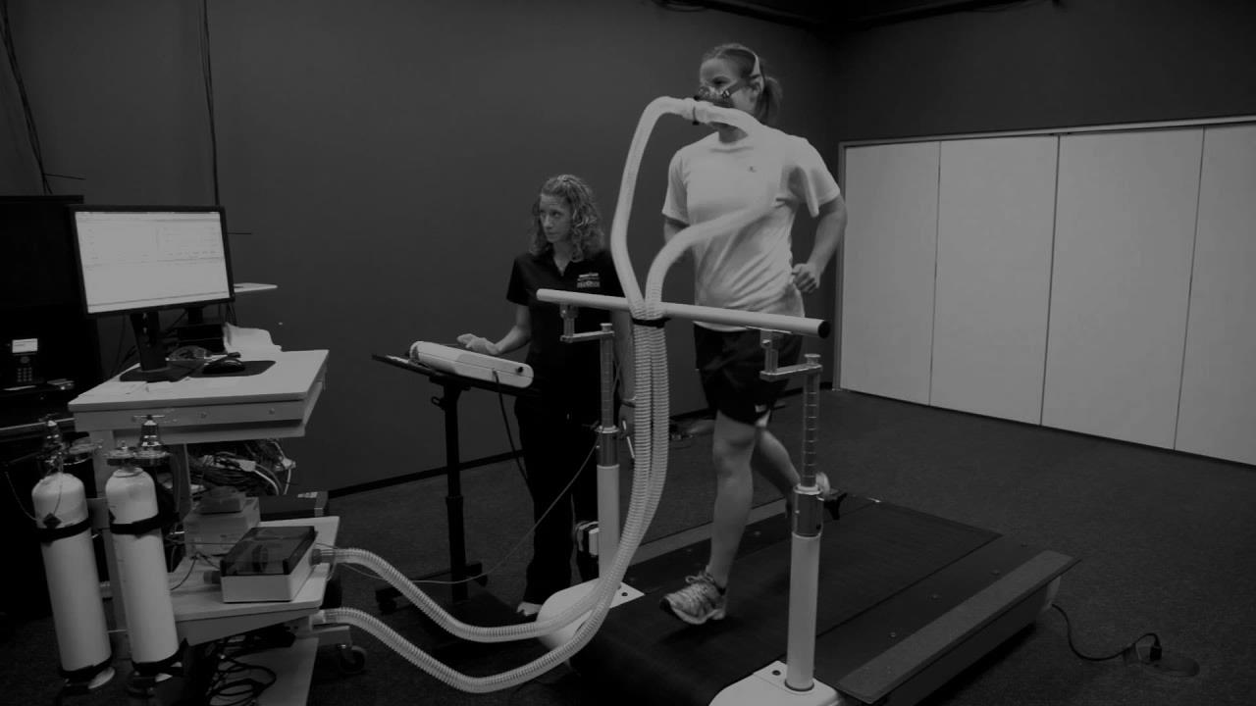




How Pros do it?
Cardio-Respiratory Lab Tests
Notes:
Professionals know this,
So they have their “sweet spot” found by laboratory exams
performed in specialized sports clinics,
where trained professionals study all the systems involved in physical activity:
respiratory, cardiac, musculoskeletal and metabolism.
(1:05)

Slide 5
How Pros do it?
Cardio-Respiratory Lab Tests
Expensive
Time Consuming
Indoor Setting
One-time measurement
Notes:
These exams, while useful, have some pitfalls:
Not only are they expensive and time-consuming,
But they are also limited to be a one-time indoor-setting measurement,
meaning that those results tell what happened in that specific session ONLY.
(1:20)

Slide 6
Running
USA: 30,000 Running Events(2017)*
World: Event Participation Growth
+49,4%(2008-2018)**
90%
wear tracking devices
50%
focused on improving
USA: 56 Million ppl(2017)*
EU: 50 Million ppl(2015)*
*Running USA 2017 National Runner Survey
**Run Repeat Marathon Statistics 2019 Worldwide
Notes:
But, when all over the world,
more and more people are making running
a part of their lifestyles
Lab tests are not suitable for everyone.
Among all kinds of runners, tracking and improving performance is a major concern…
https://runrepeat.com/research-marathon-performance-across-nations

Slide 7
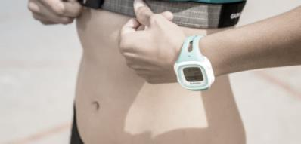

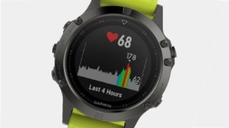

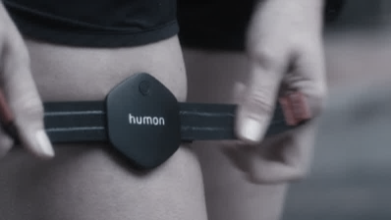

Outside the lab
Wearable Devices
Notes:
This is why , outside the lab, most athletes use wearable devices,
as they are the most convenient way to track performance.
Cardio is very well covered by a wide offer of heart rate monitors
For musculoskeletal performance, there are some emerging options in the market
But,
what happens with respiratory activity monitoring?
(2:00)

Slide 8
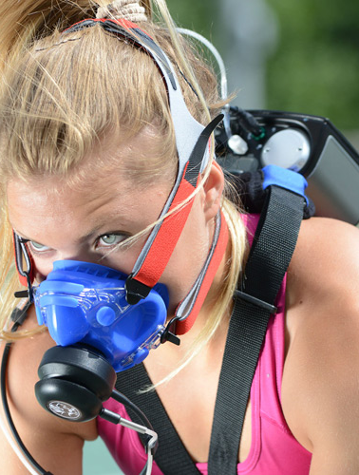
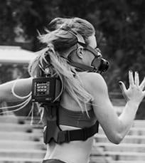
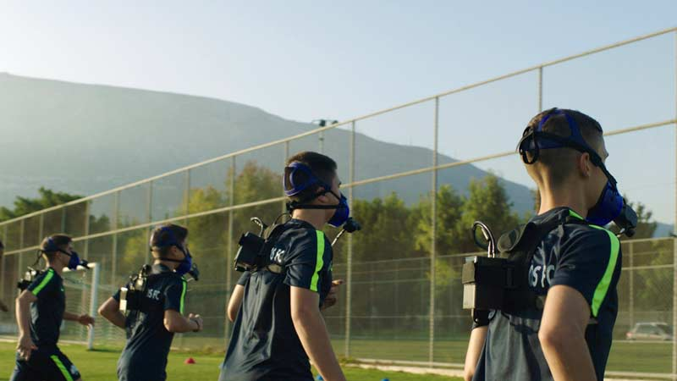
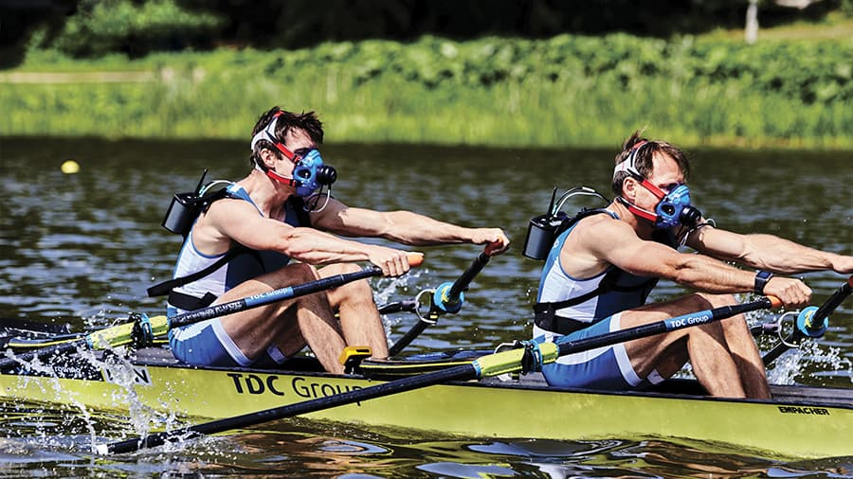
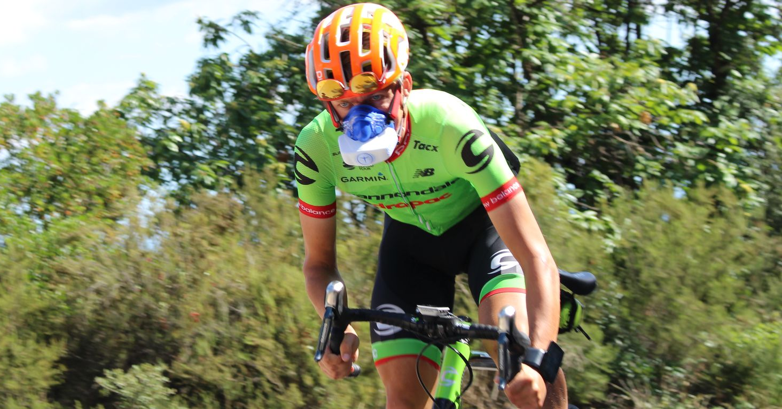
Best Alternative?
Notes:
In the field, pro-athletes use portable spirometers,
Which involves the use of a backpack computer
and a facemask that makes breathing uncomfortable.
Also it requires a trained professional to interpret data.
**** Aquiles Heel. What are those? Timing. Market studies. Design Validation.

Slide 9

Our Solution:
Optimize endurance on the run
Notes:
With all of this in mind we thought,
how can we provide a tool to measure respiratory parameters and improve performance while training
in any place, at any condition, in a lean way?
(2:20)

Slide 10


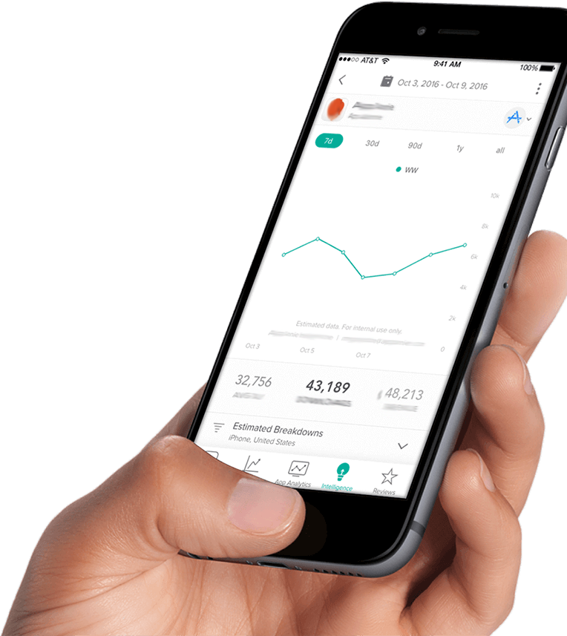
CHASKI™
Wearable Respiratory Activity Tracker
Wireless Connection
to Smartphone or Smartwatch
Real-Time Feedback
Progress Tracking
AI-based Training Support
Notes:
So, we created Chaski, a wearable respiratory activity tracker
that can provide real-time feedback of your training intensity.
Through a wireless connection to a smartphone or smartwatch…
Chaski can keep track of your progress, analyze your data and support your training
Now, you can understand what is actually happening in your body
And, this way, improve your training routines
(3:00)

Slide 11
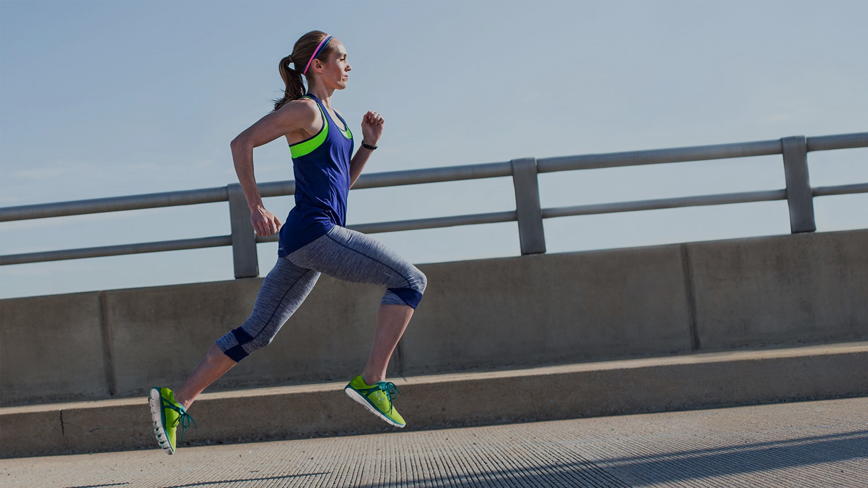


How does it work?
While Training
Get Feedback
Anaerobic Threshold
Real time alarm
“You have reached the threshold”
After Training
Get Insights
Check your performance
Plan your next session
Notes:
How does it work?
When training, if you are about to burn out,
Chaski will ring an alarm
Telling you need to slow down.
After training, in the app you will be able to get insights,
check your performance and plan your next session

Slide 12
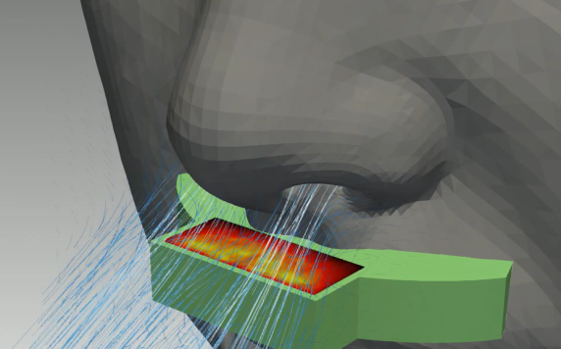
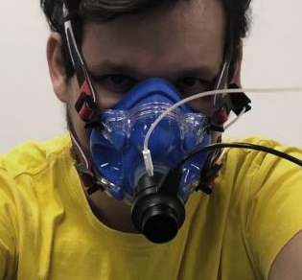
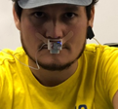
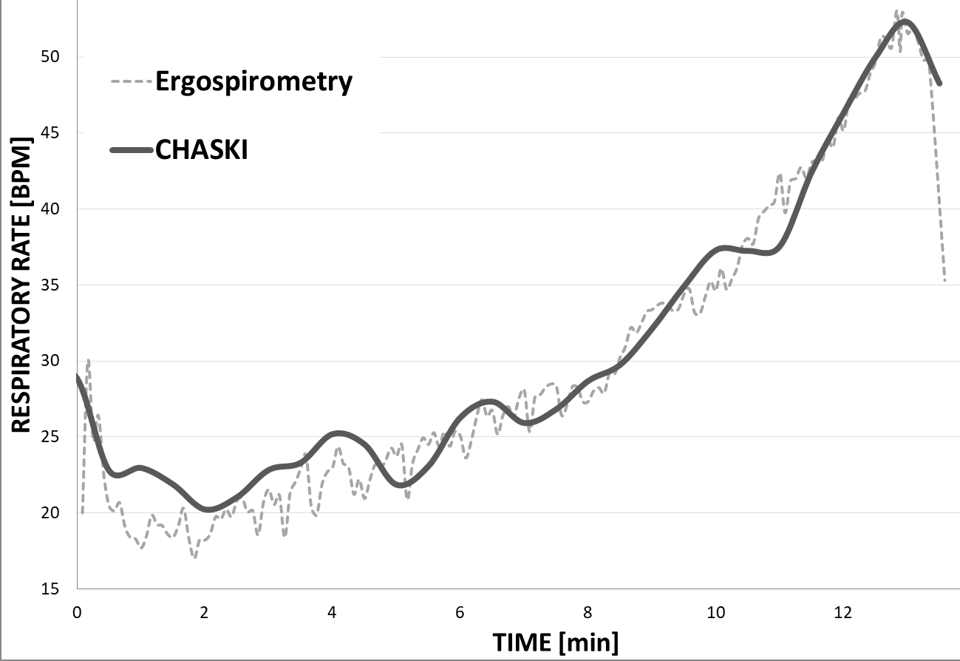
TECH & IP
Dashed Line: Traditional lab test
Solid Line: CHASKI
Respiratory Rate Measurement
RR Analysis for Threshold Detection
Patent Pending
“Techniques for quantifying respiration using a wearable device and related systems and methods”
Notes:
Our patent-pending technology can measure respiratory activity directly from nose and mouth
With high accuracy when compared to the laboratory gold standard.
Then, through real-time analysis of these signals,
we can detect when the threshold is being crossed

Slide 13
Weight (Including Battery)
49 grs
Direct RR Measurement + Gas Exchange
Direct RR Measurement
N/A
Ventilation Metrics
Direct RR Measurement + Gas Exchange
880 grs
User-Friendly UI
Price
$399
$7,500-$20,000
$300
(each test)
Yes
NO
(requires trained professional)
NO
(requires trained professional)
CHASKI
Portable Ergoespirometry
Laboratory Ergoespirometry
Mobility
Medium
(Mostly Testing and limited training)
None
(Test only)
High
(Test and Train ready)
Notes:
Chaski gives you the access and freedom that traditional solutions cannot deliver.
Chaski provides ventilation metrics to a wider audience with a device that is affordable, comfortable, easy to use
and which can be used in the actual place where you train.

Slide 14
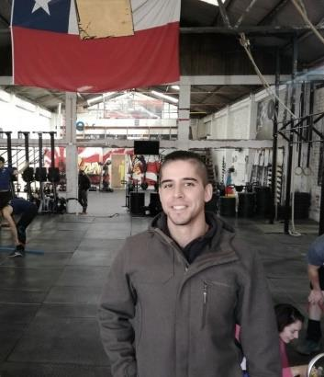
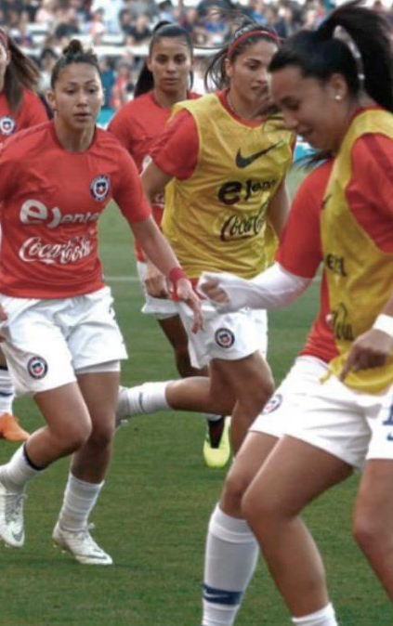
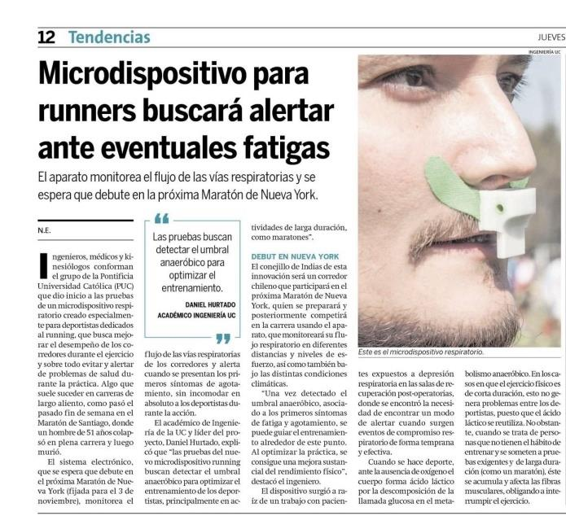
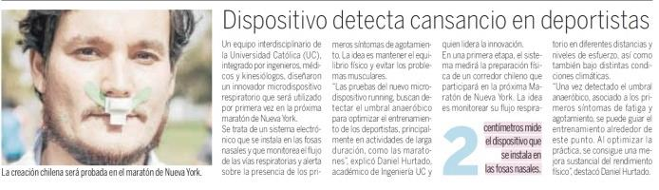
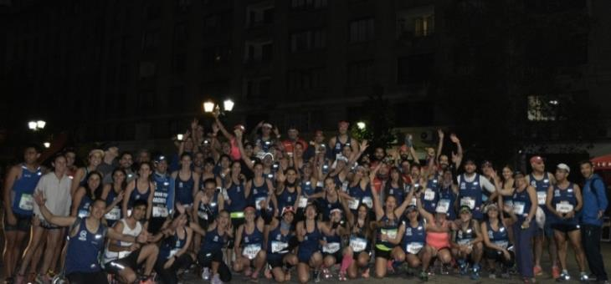

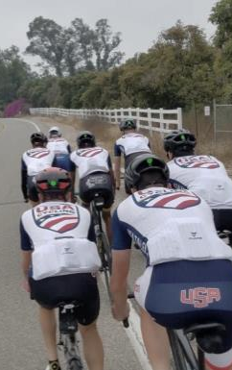
*microdevice for runners alerts eventual fatigues
*Device detects athletes fatigue
*Device allows improving sports performance
Notes:
All of this has attracted attention from media, both TV and newspapers, with very good reception
Also, we will soon run a pilot study with the women’s national soccer team of Chile
In Chile and the USA, athletes from disciplines from running, cycling and even crossfit have validated the concept
and are waiting to try the first release of the device.

Slide 15
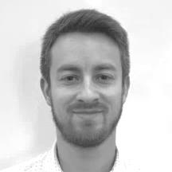
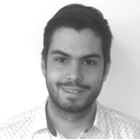

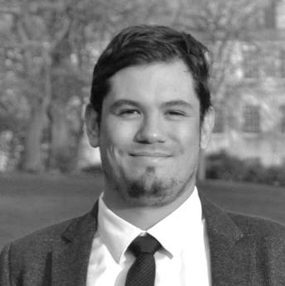
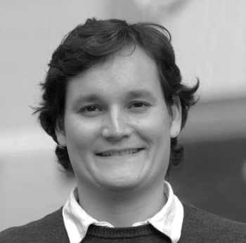

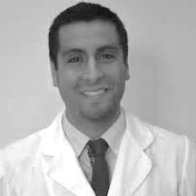

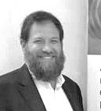
TEAM
Management
R&D
Roberto Lopez,PhD
Project Engineer
Javier Kunstmann
Product Owner
Angel Abusleme,PhD
Tech Advisor
Macarena Rodriguez
Triathlete/Physiologist
Felipe Contreras,PhD
Sports Physiologist
Vader Johnson, MSc
Founder & CEO
7yrs xp. Medtech Entrepreneur
National Engineering Institute Awardee
Daniel Hurtado, PhD
Founder & CSO
15yr xp. Biomechanics
Young Scientist at World Economic Forum.
Advisors
Nancy Levy,PhD
Managing Partner Boston Landing
Business Advisor
David Rothkopf
President of MEDIcept
Development Advisor
Notes:
This endeavor is being led by our experienced management team in product development and scientific research.
Our R&D Team is comprised by people from diverse areas such as engineering, sports physiology and business.
And we are being supported by world class advisors from the MIT idea2 program.
*award winning

Slide 16
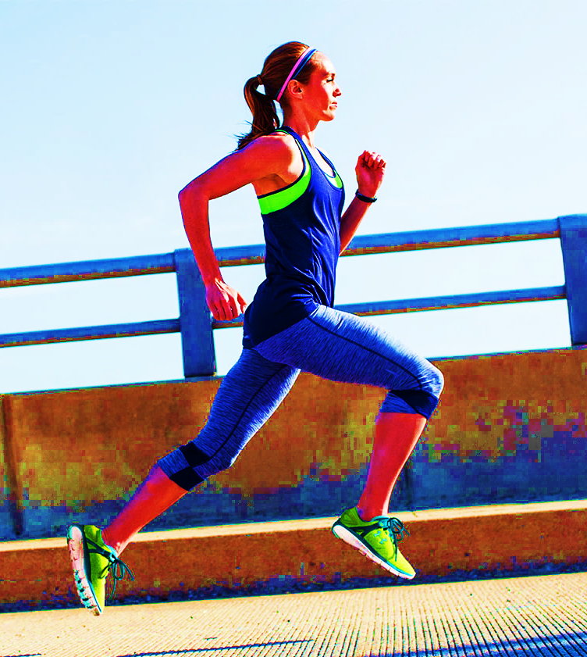
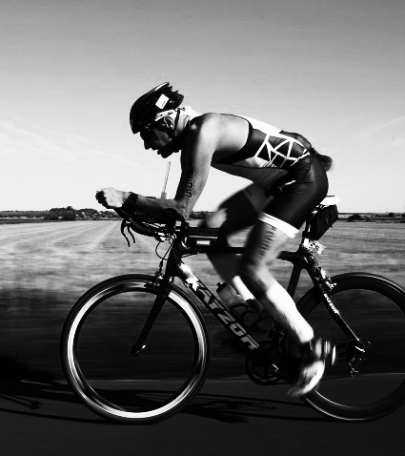
Serious/Competitive
Runners & Cyclists
Runners
Cyclists
Initial Total Available Market
USA + EU + China : 36,5 Million ppl
Notes:
We are creating solutions for a large and growing market of serious and competitive athletes in the US, Europe and China
that are eager to try new ways to improve their performance
runners and cyclists
https://www.reuters.com/brandfeatures/venture-capital/article?id=67095

Slide 17
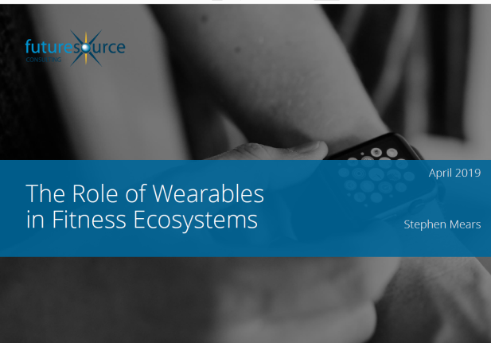
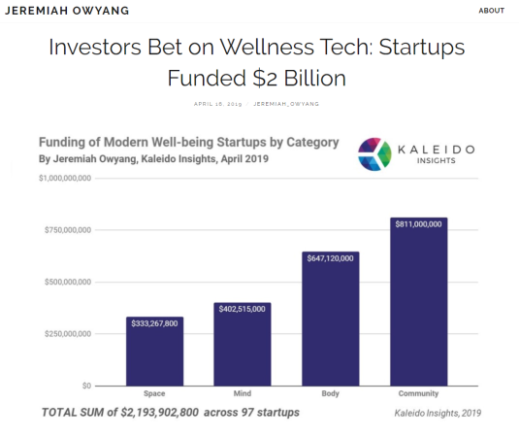
“The ‘digital fitness wave’ is gathering momentum […], and has yet to reach its peak.”
2019. FutureSource Consulting, UK: The Role of Wearables in Fitness Ecosystems
WellnessTech categories with the most potential to grow:
New sensors and software that can accurately measure breathing
may blossom into new business models.
2019. Kaleido Insights, USA: Investors Bet on Wellness Tech: Startups Funded $2 Billion
Notes:
And industry experts from the USA, the UK and other parts of the world claim that there is growing need for new alternatives in fitness and sports technology.
This can translate into a great growing potential

Slide 18
CHASKI™ wearable respiratory analysis for athletes
Boston, December 2019
Vader A. Johnson
Daniel E. Hurtado
vjohnson@icinnovations.cl
daniel@icinnovations.cl
Notes:
So, join us in our challenge to make respiratory analysis available to all kinds of athletes
Thank you

