Slide 1
A miRNA-Based Strategy to Improve Regenerative Medicine in Diabetes
A new therapeutic approach for regeneration
MIT-IDEA²

Slide 2
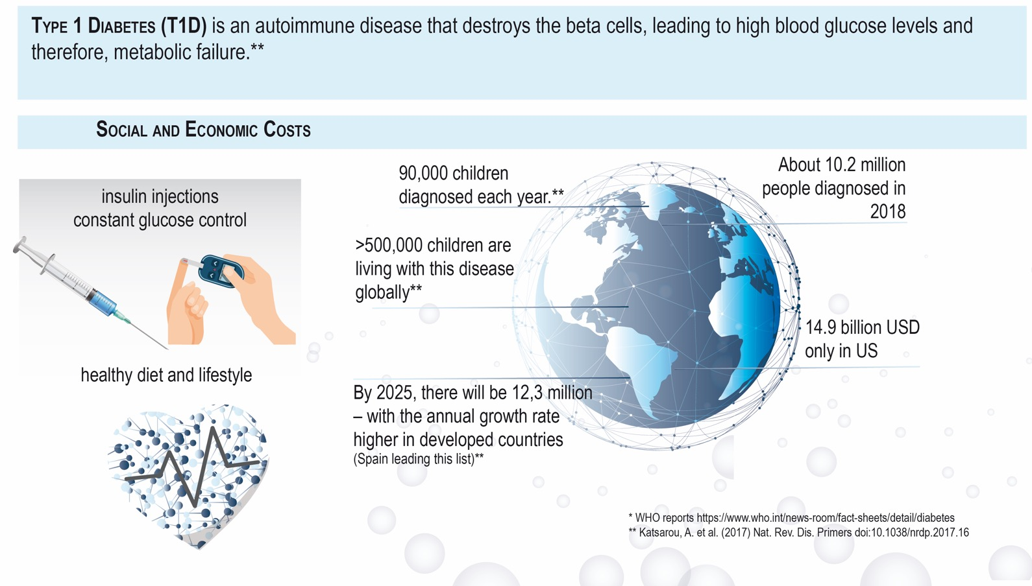
Type 1 Diabetes is AN UNMET NEED
MIT-IDEA²

Slide 3
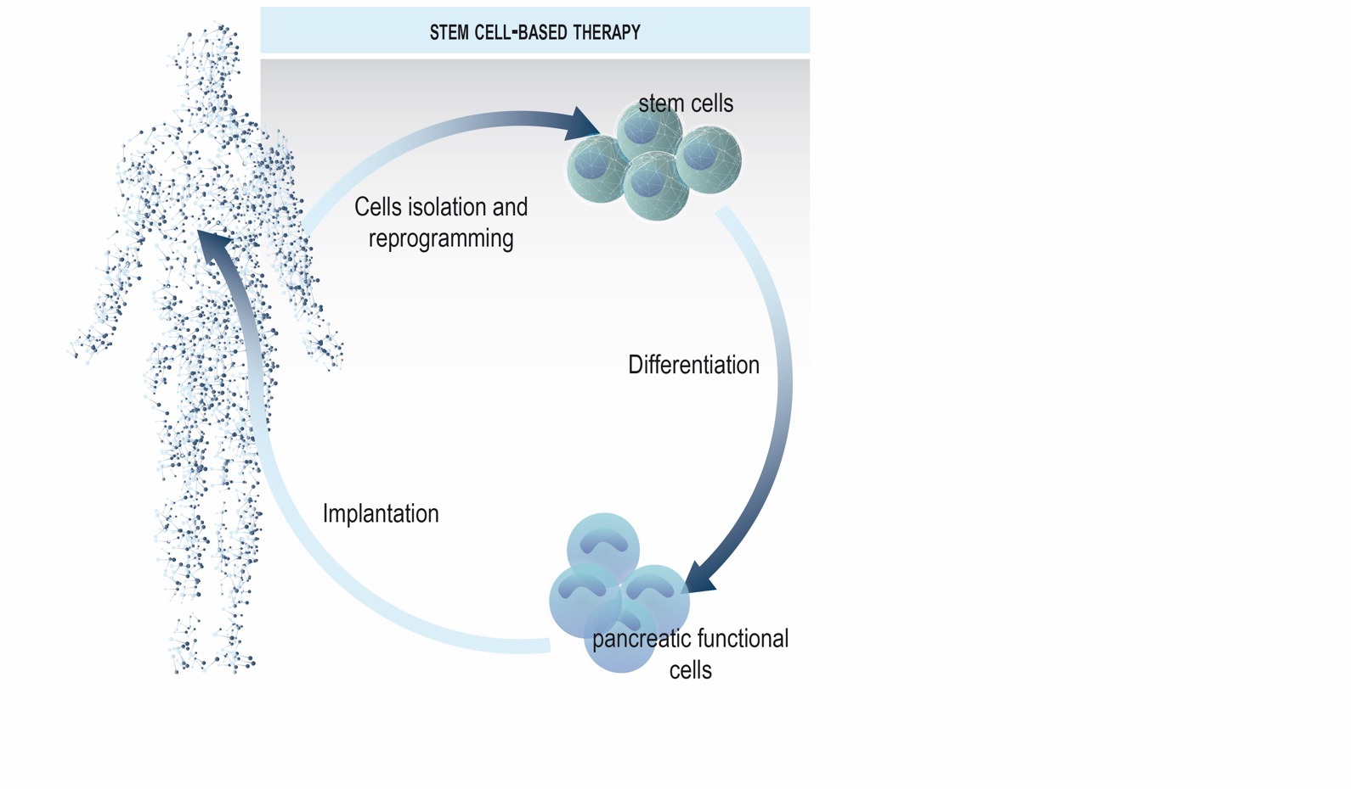
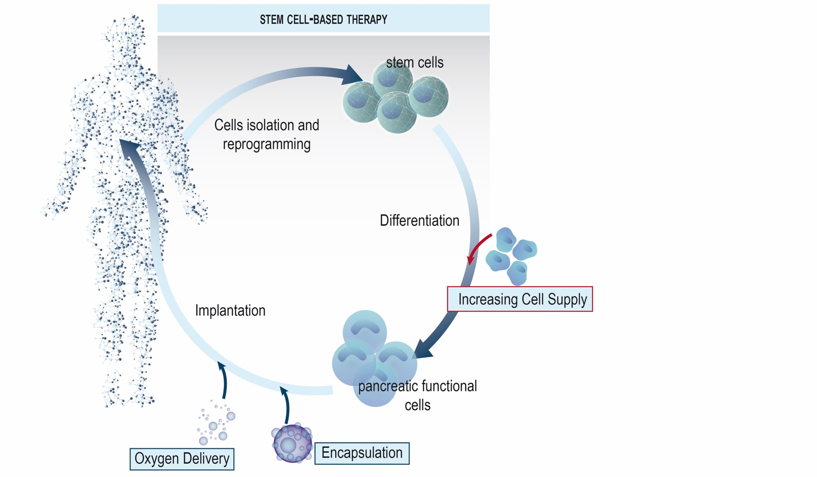
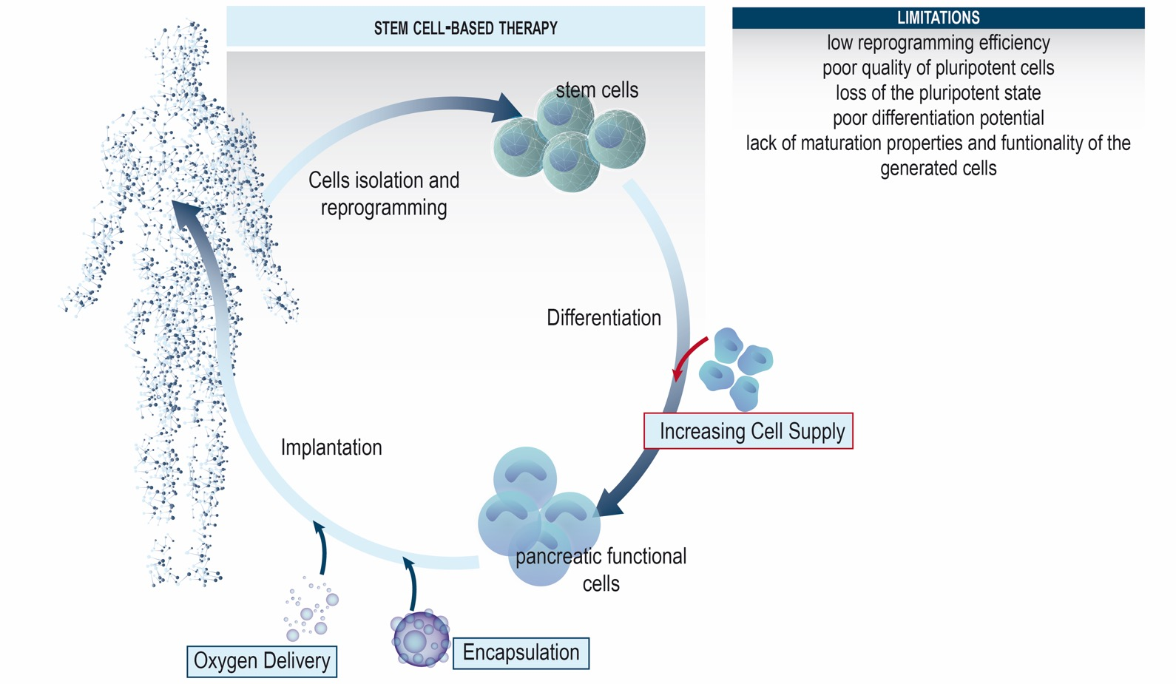
THE PROBLEM : regenerative therapies in T1D are the “holy grail”, but still show limited success
MIT-IDEA²

Slide 4
OUR PRODUCT : MImoPancreas capable of producing insulin
Our vision: Long-life restoration of blood glucose control
50μm
50μm
Insulin (green); mucin1 (red); nuclei (blue)
• We are intended to be not only better but different from our competitors: our novel product, MimoPancreas, is much more than a cluster of cells, but a self-organized tridimensional structure that accomplishes different pancreatic cell types together, working together for a more efficient outcome.
Interestingly enough, MimoPancreas are created from pancreatic progenitors (avoiding concerns about pluripotency of ESCs/IPSCs).
• miR-based technology makes them mature, functional and stable.
MIT-IDEA²

Slide 5
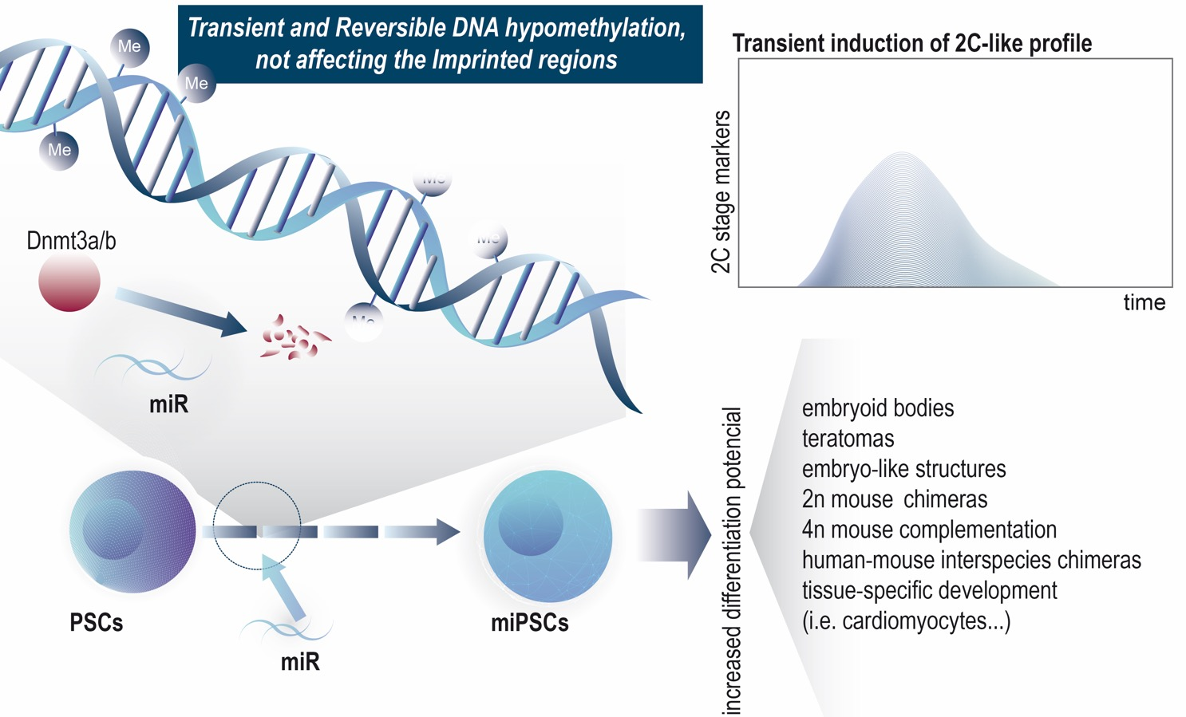
THE MECHANISM OF ACTION of our miR, deeply studied during the last 5 years on stem cells
MIT-IDEA²

Slide 6
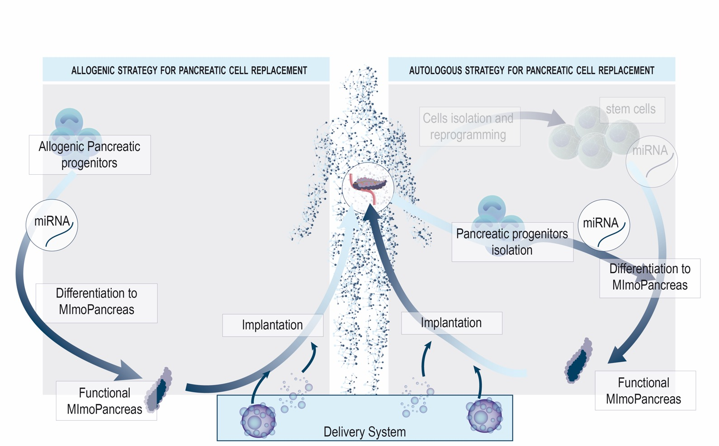
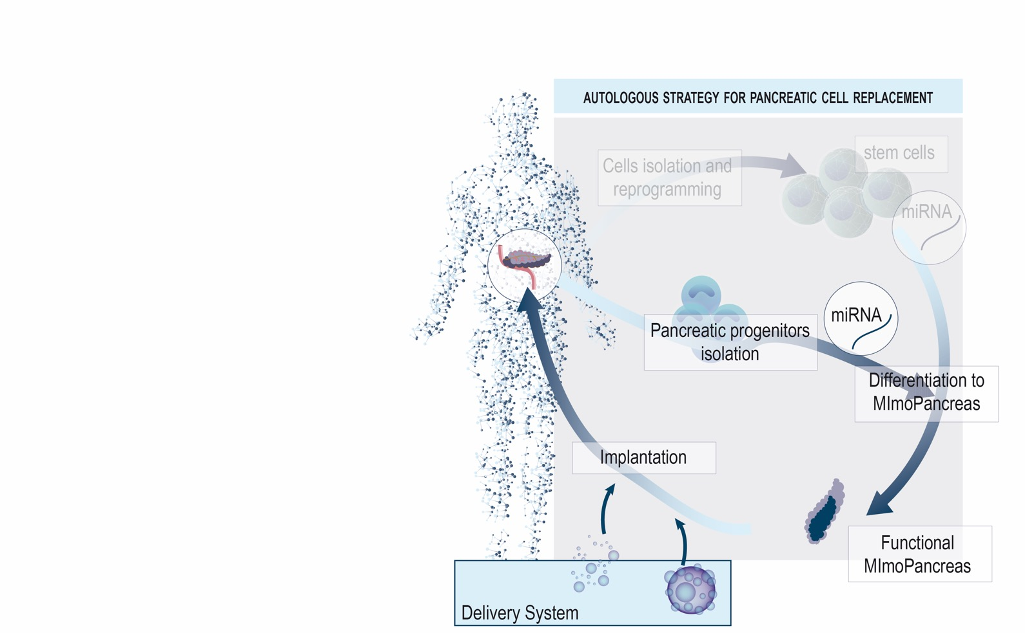
OUR TECHNOLOGY : MImoPancreas for cell replacement
MIT-IDEA²

Slide 7
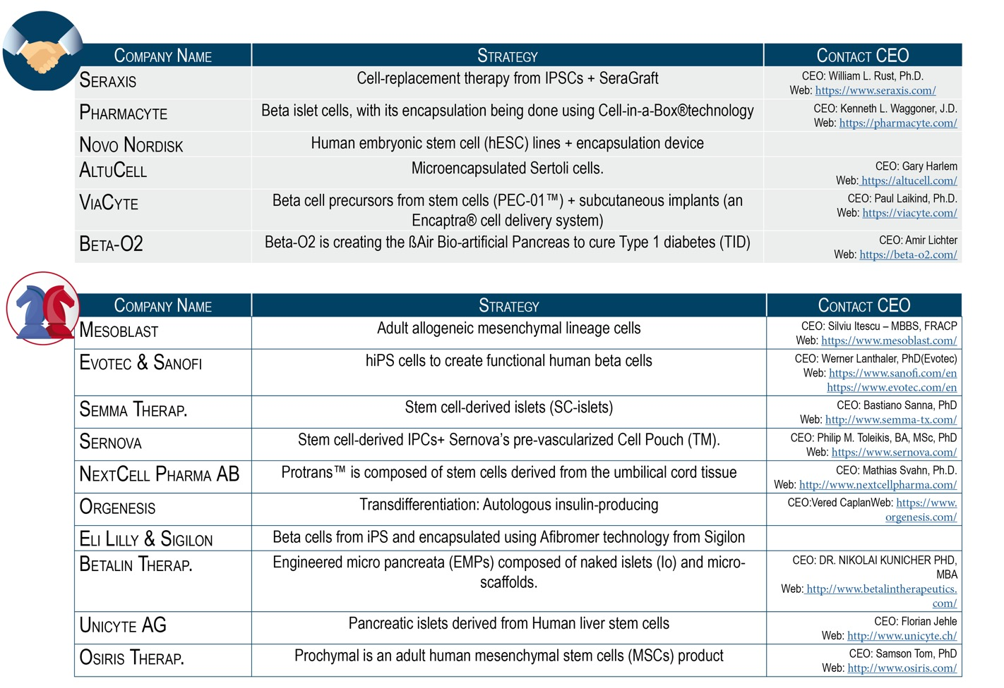
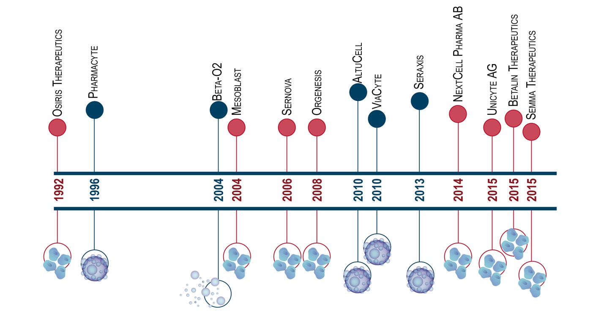
Our market strategy: making STRATEGIC ALLIANCES
MIT-IDEA²

Slide 8
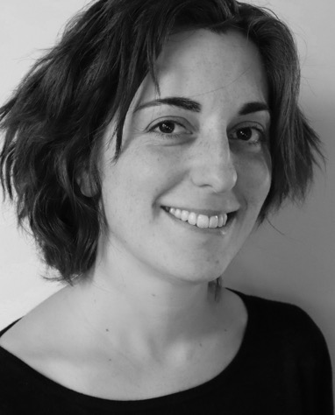
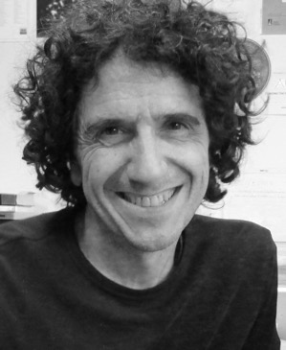
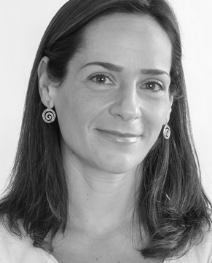
OUR TEAM – stem cell biology frontier research
OUR Advisors
Petra Krauledat (CEO atPNPResearch)
Peter Bryant (professor at IE Business School)
José Luis Cabero (CEO at AELIX)
Sotirios Karathanasis (VP at NeoProgen)
OTHER TEAM MEMBERS
Marcos Malumbres, PhD
Scientific Advisor (CNIO)
Nuria García, PhD student
Aicha El Bakkali, Technician
Carolina Pola, PhD
Director Of Innovation at CNIO
basic and translational research in cell cycle and stem cell biology
GEMMs models, drug discovery projects with small molecules, advanced therapy approaches for cell therapy and organoid development.
María Salazar Roa, PhD
Project Manager (CNIO)
Scientific approach and capabilities
Mouse models to study the cell cycle machinery
Mechanisms regulating the cell division cycle and its effects on cell fate, disease and therapy
Function of microRNAs in stem cell biology, regenerative medicine and tumor development
How progenitor cells and cancer stem cells control their self-renewal and proliferative properties
Discoveries and innovations of the group
Role of CKD4/CDK6 in cancer and disease mouse models
Cell cycle-dependent kinase Plk1 as regulator of vascular homeostasis
PP2-inhibitory kinase MASTL as a potential target for cancer – PoC in vitro and in vivo and drug discovery campaign ongoing.
Mouse models for miRNAs, with relevant properties in self-renewal and differentiation of stem cells.
Staff scientist at CNIO. More than 6 years of experience in stem cell biology, cell proliferation and differentiation. 37 articles (9 as first author, 2 as corresponding author); more than 8.000 citations; one patent directly related to the asset; awarded by MIT (Boston, US) and Caixa (Barcelona, Spain) to participate in IDEA² Global 2019 and CaixaImpulse 2019 valorization and mentorship programs.
MIT-IDEA²

Slide 9
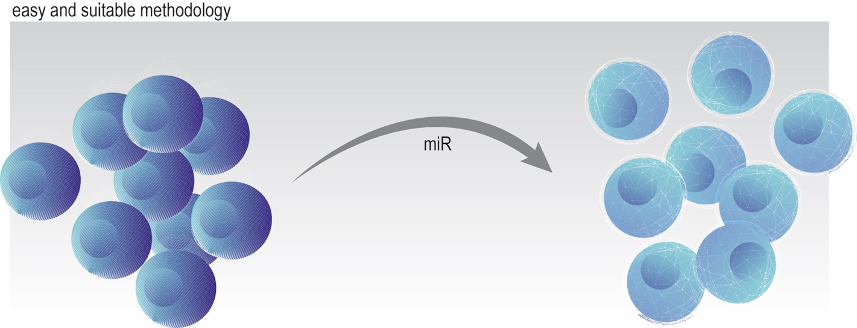
OUR MISION is making the cure possible
…REVOLUTIONIZING REGENERATIVE THERAPY for Type 1 Diabetes
MIT-IDEA²

Slide 10
A miRNA-Based Strategy to Improve Regenerative Medicine in Diabetes
A new therapeutic approach for regeneration
María Salazar-Roa, PhD
Staff Scientist at CNIO
msalazar@cnio.es
linkedin/maria-salazar-roa
MIT-IDEA²

Slide 11
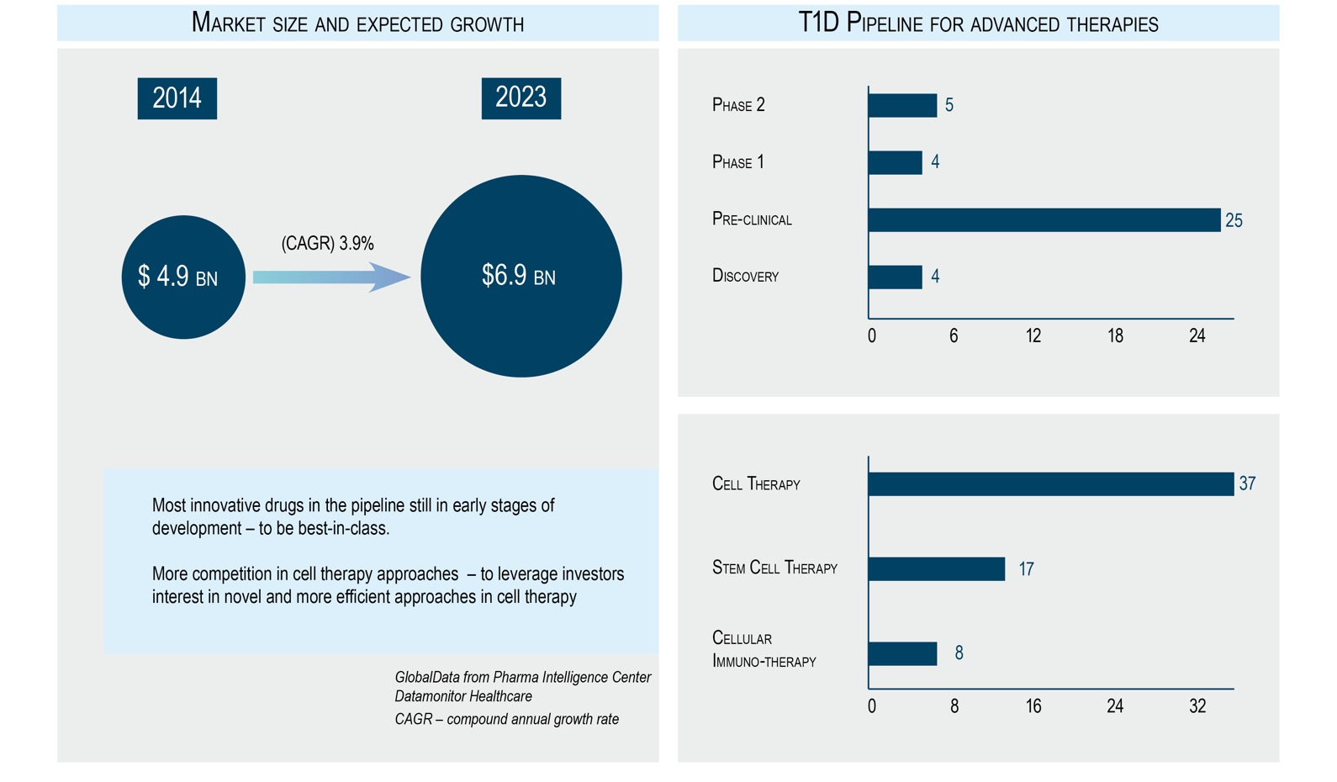
THE MARKET OPPORTUNITY in Type 1 Diabetes

Slide 12
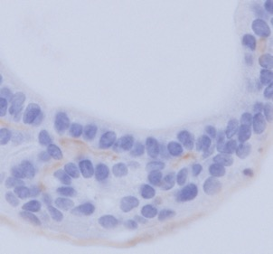
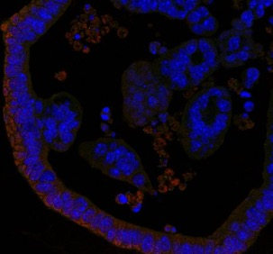
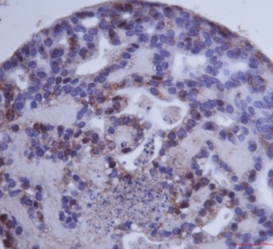
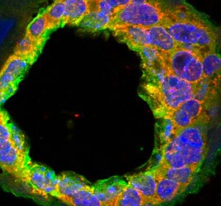
THE PRODUCT : MImoPancreas capable of producing insulin
miRNA-exposed pancreatic organoids efficiently generate insulin-producing cells
Control pancreatic organoids
Insulin (IHC)
Insulin/ Mucin1/ Dapi (IF)
MImoPancreas
Insulin (IHC)
Insulin/ Mucin1/ Dapi (IF)

Slide 13
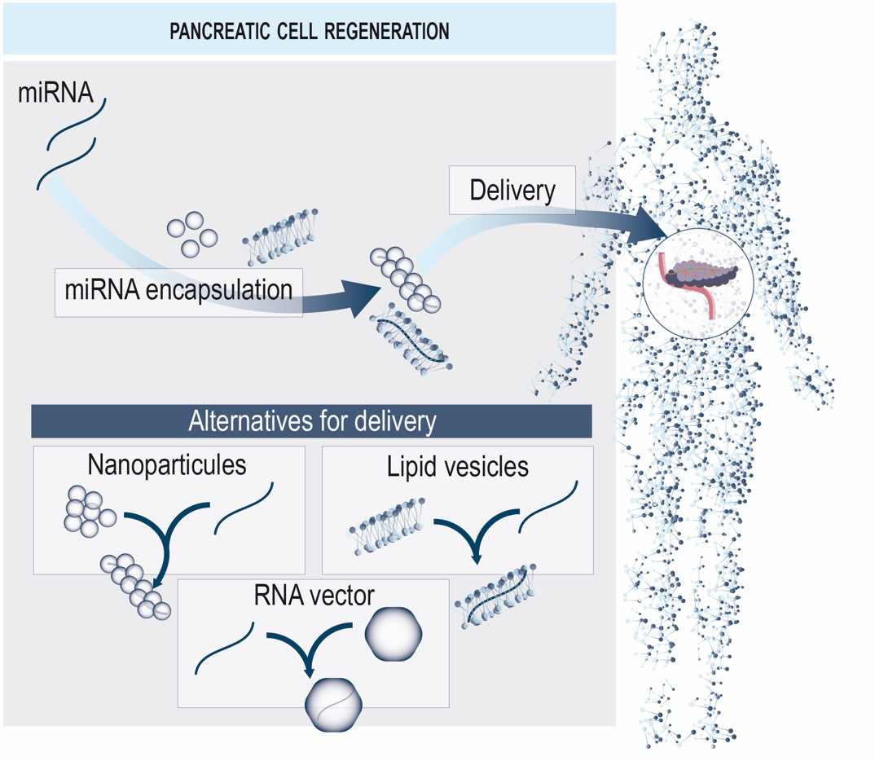
We have a MITIGATION ALTERNATIVE : miR-based strategy in pancreatic cell regeneration

Slide 14
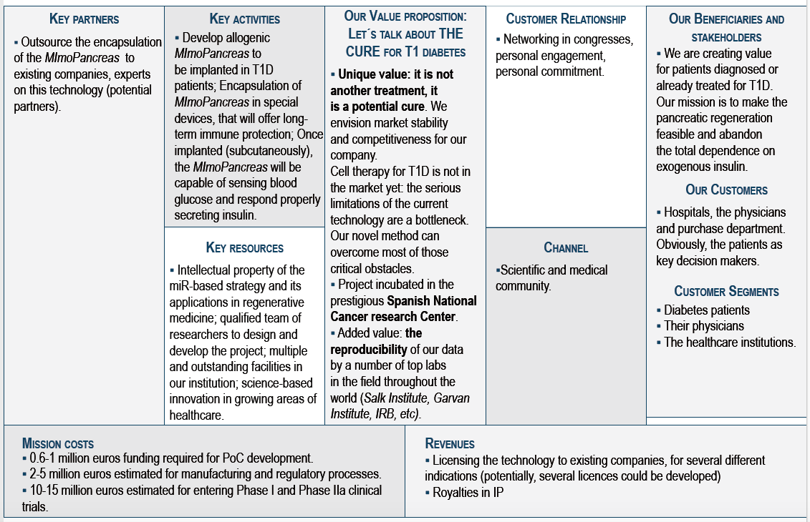
OUR BUSINESS MODEL

Slide 15
Phases of our (rolling) plan

Slide 16
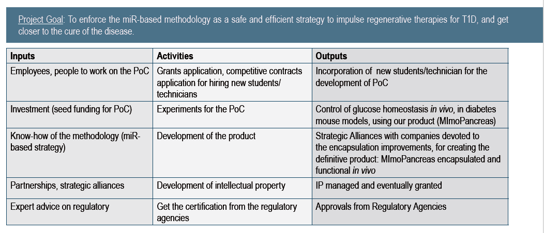
VALORISATION PLAN: global activities and PoC assays
Notes:
It has scalable smart health architecture focusing on the origin of the diseases, that is tracking the fluid motion,
The brain behind the idea is a multidisciplinar team of engineers and medical doctors,
And the project has application on the global market, with a commercialization strategy divided in the system and the algorithms for applications and personalization

Slide 17
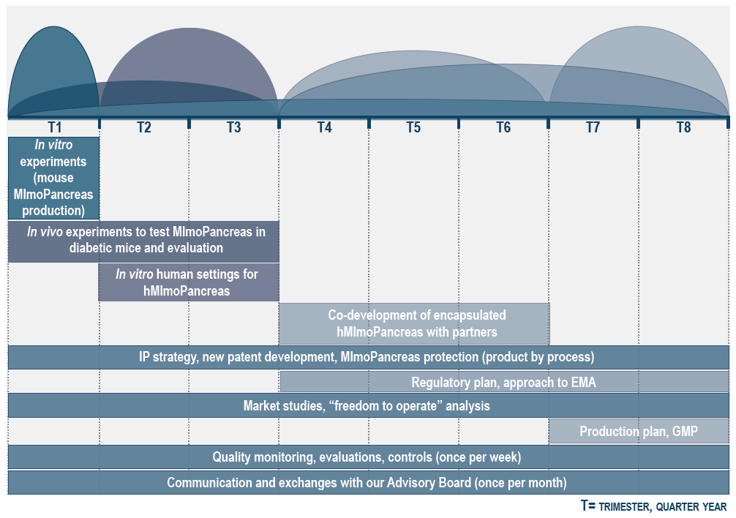
VALORISATION PLAN: Calendar for the next 2 years
Notes:
It has scalable smart health architecture focusing on the origin of the diseases, that is tracking the fluid motion,
The brain behind the idea is a multidisciplinar team of engineers and medical doctors,
And the project has application on the global market, with a commercialization strategy divided in the system and the algorithms for applications and personalization

Slide 18
UPDATE for IDEA²: key accomplishments
We have refined the sales pitch.
We are working on our valorisation plan. Our deadline to finish the document is November 8th.
We are developing new sets of experiments on the lab to reinforce the original data. Getting ready to build a solid proof of concept.
We are starting to set up the in vivo experiments, using Diabetes mouse models.
We are applying to different competitive calls for getting funding and a PhD student to accomplish our PoC.
We are mentored by three experts on business, technology transfer, finance and commercialization tools:
Petra Krauledat (Principal owner and Chief Executive Officer at PNPResearch Corporation; IDEA²), Peter Bryant (professor of entrepreneurship at IE Business School) and José Luis Cabero (life science manager, mentor and advisor- Chief Executive Officer at AELIX Therapeutics). They monitor our work and we have frequent meetings to follow up. We are also mentored by an expert on the field, Sotirios Karathanasis (Vice President R&D at NeoProgen).
We are in conversations with Christopher Mann (Scientific Regulatory Associate Director in Asphalion).
Chris and his team are experts on advanced therapies in endocrine diseases, and they are of great value to define the easiest and accessible strategy, in terms of Regulatory.
We are in conversations with Gustavo Fuster (European patent Attorney in Hoffmann Eitle).
He will help us to reinforce our patent and define the new IP protection, based on this project.

