Slide 1
CareBridge
MIT IDEA2 2022

Slide 2
Background/Problem
Economic Barrier
Stressful Environment
Medical Racial Stigma
Inaccessibility
Does not fit with patient culture, lacking of trust
54% BIPOC and LGBTQ2S+ have risk of failure to access equitable essential health
Job losses, high
cost of care
Lack of support from community, unclear information
Need for culturally competent care

Slide 3
Solution
Mobile app that connects patients to a patient care facilitator.
Goal: Increase accessibility & trust

Slide 4
Key Components of App Interface for Patients
1
2
3
4
Initial questionnaire
Algorithmic-based matching to facilitators
Collects biodata on the patient to synthesize their app profile
AI based algorithm that connects patients with culturally-proficient facilitators based on the questionnaire.
Chatbox with facilitators
Summary Form
24/7 access to emergency consultation
chatbox to consult with matched facilitator offline
Document recapping the entire meeting in order to make physician care meetings run smoothly.
Notes:
The key components of the app for patients include the initial questionnaire which synthesizes a biodata based profile for the patients. As well as an algorithmic based matching questionarre to a culturally literate facilitator. Thirdly our platform include 24/7 emergency consultations as well as chat boxes with facilitators offline. The summary form that is collected at the end of a patient facilitator interaction can be given to physicians to guide the care plan.

Slide 5
Facilitators
Health Care Providers
Use the detailed report to personalize care according to patient needs.
Allow Primary Care Visits to be efficient and seamless.
Medical students + community health leaders
Maintain detailed records
Build experience working with marginalized communities

Slide 6
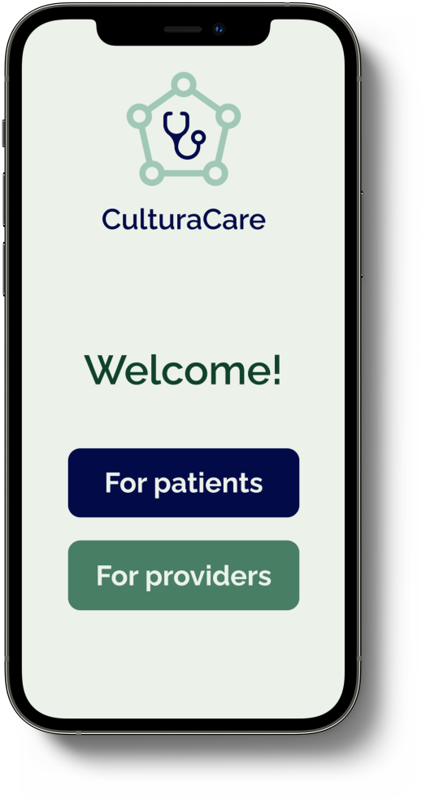
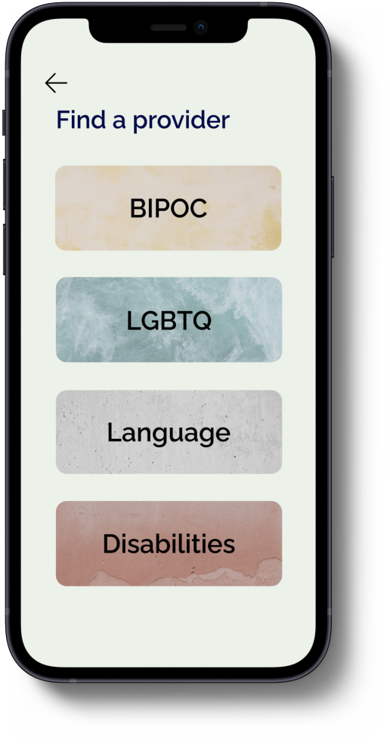
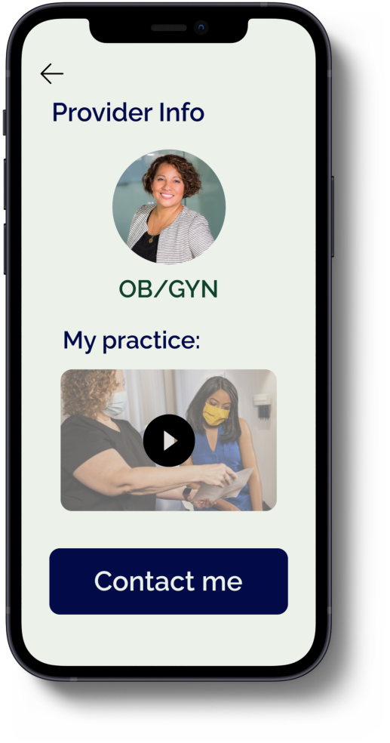

Slide 7
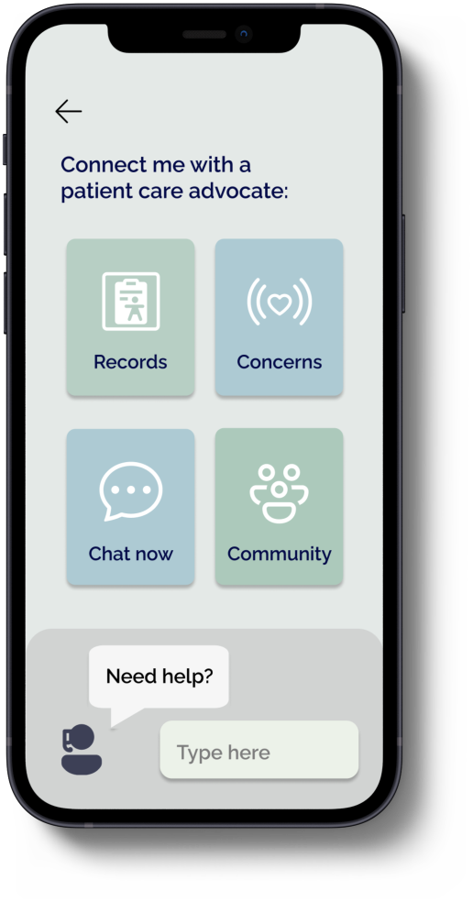
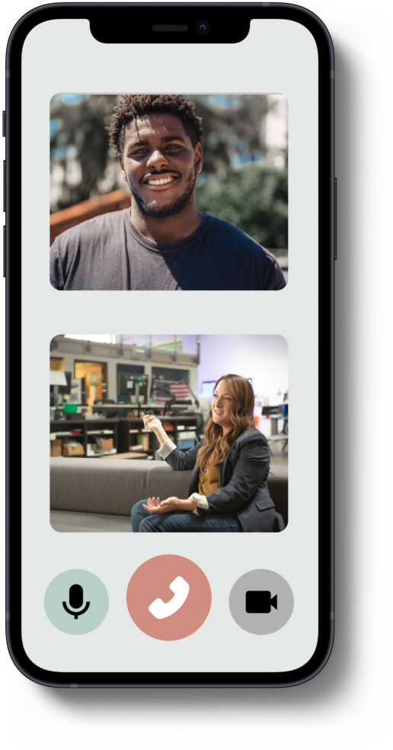
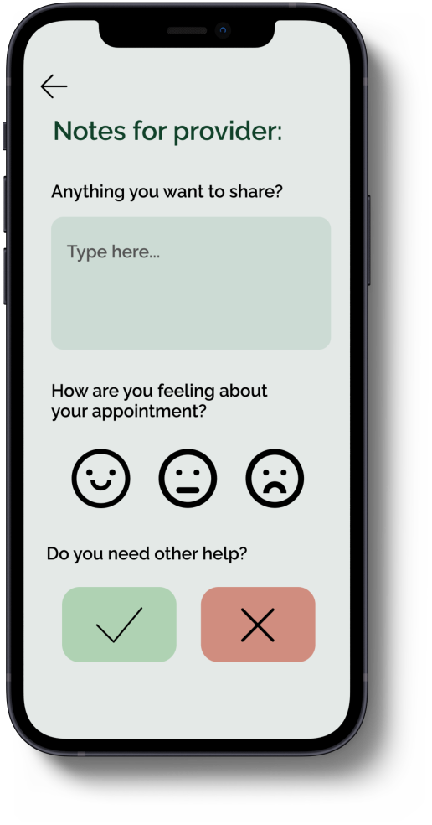

Slide 8
Business Model
Promotions and Connecting patients to physician practices + hospitals
Partnership with EHR systems

Slide 9
Current Traction
Physicians
Dr. Patel, MD: Integrating this into clinics is very simple + doctors are struggling with communicating and see huge potential for a platform that helps their skills like languages and trainings be seen more
Dr. Paula, MD: hospital visits are ineffective when patients clearly are not comfortable/ don’t open up to them (very common)
S.Scott, RN: the platform would help nurses direct care as they would have notes to go off of
Individuals/ Patients from Marginalized Communities (anonymous)
Don’t go to the doctor often because they don’t have an actual relationship with them (first physician they could find online)
Culturally, [my] health goals are different, [my] doctor doesn’t understand that
I can’t speak clear English so my appointments are very short and the doctor just assumes everything is ok
I always forget to talk about what is important to me during the actual visit- I remember afterwards but then I forget in the next 6 months before an appointment
Medical School Students/ Community Health Leaders (potential patient facilitators)
We (med-school students) would be good fits for the platform as we are well-versed in these skills
We learn a lot about this issue and healthcare inequities and this gives us as students a direct way to do something about the problem
As a community health advocate, I try my best to help match people manually that could help one another but an app that does it would help so many people beyond my one circle

Slide 10
Future Plans
Web platform for accessibility
assistive technology

Slide 11
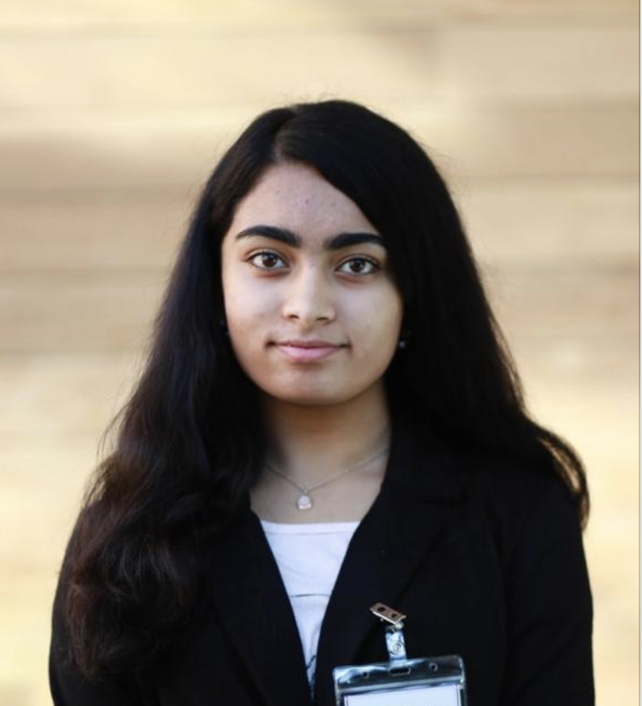
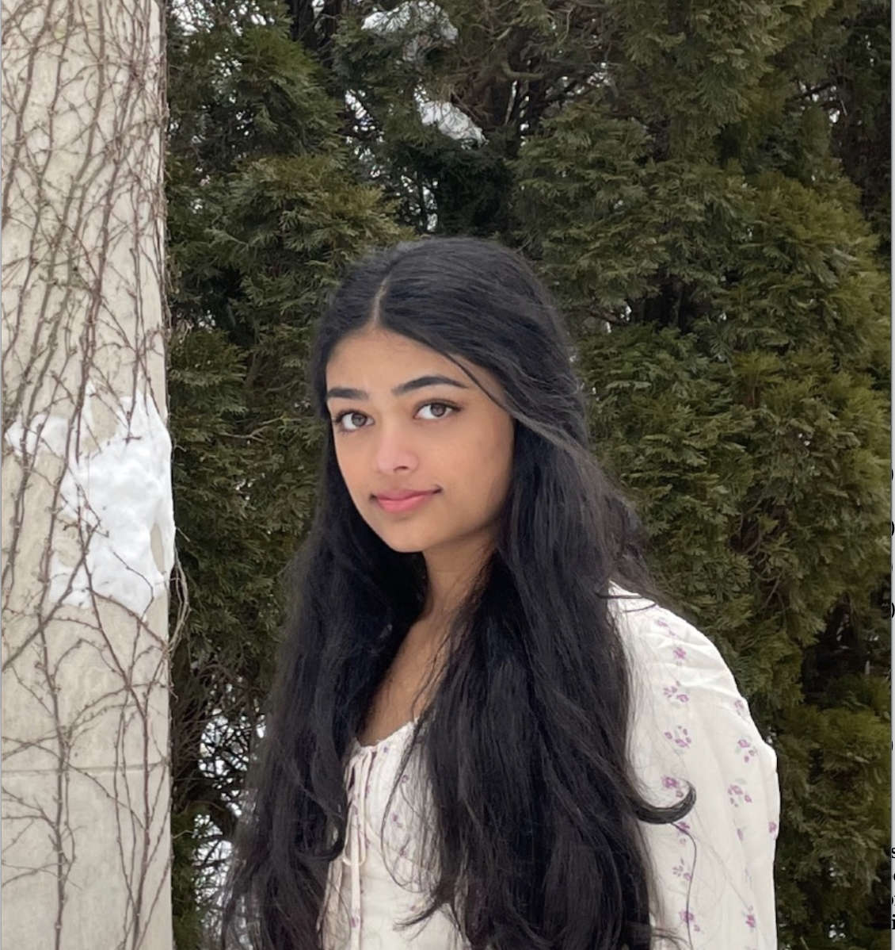
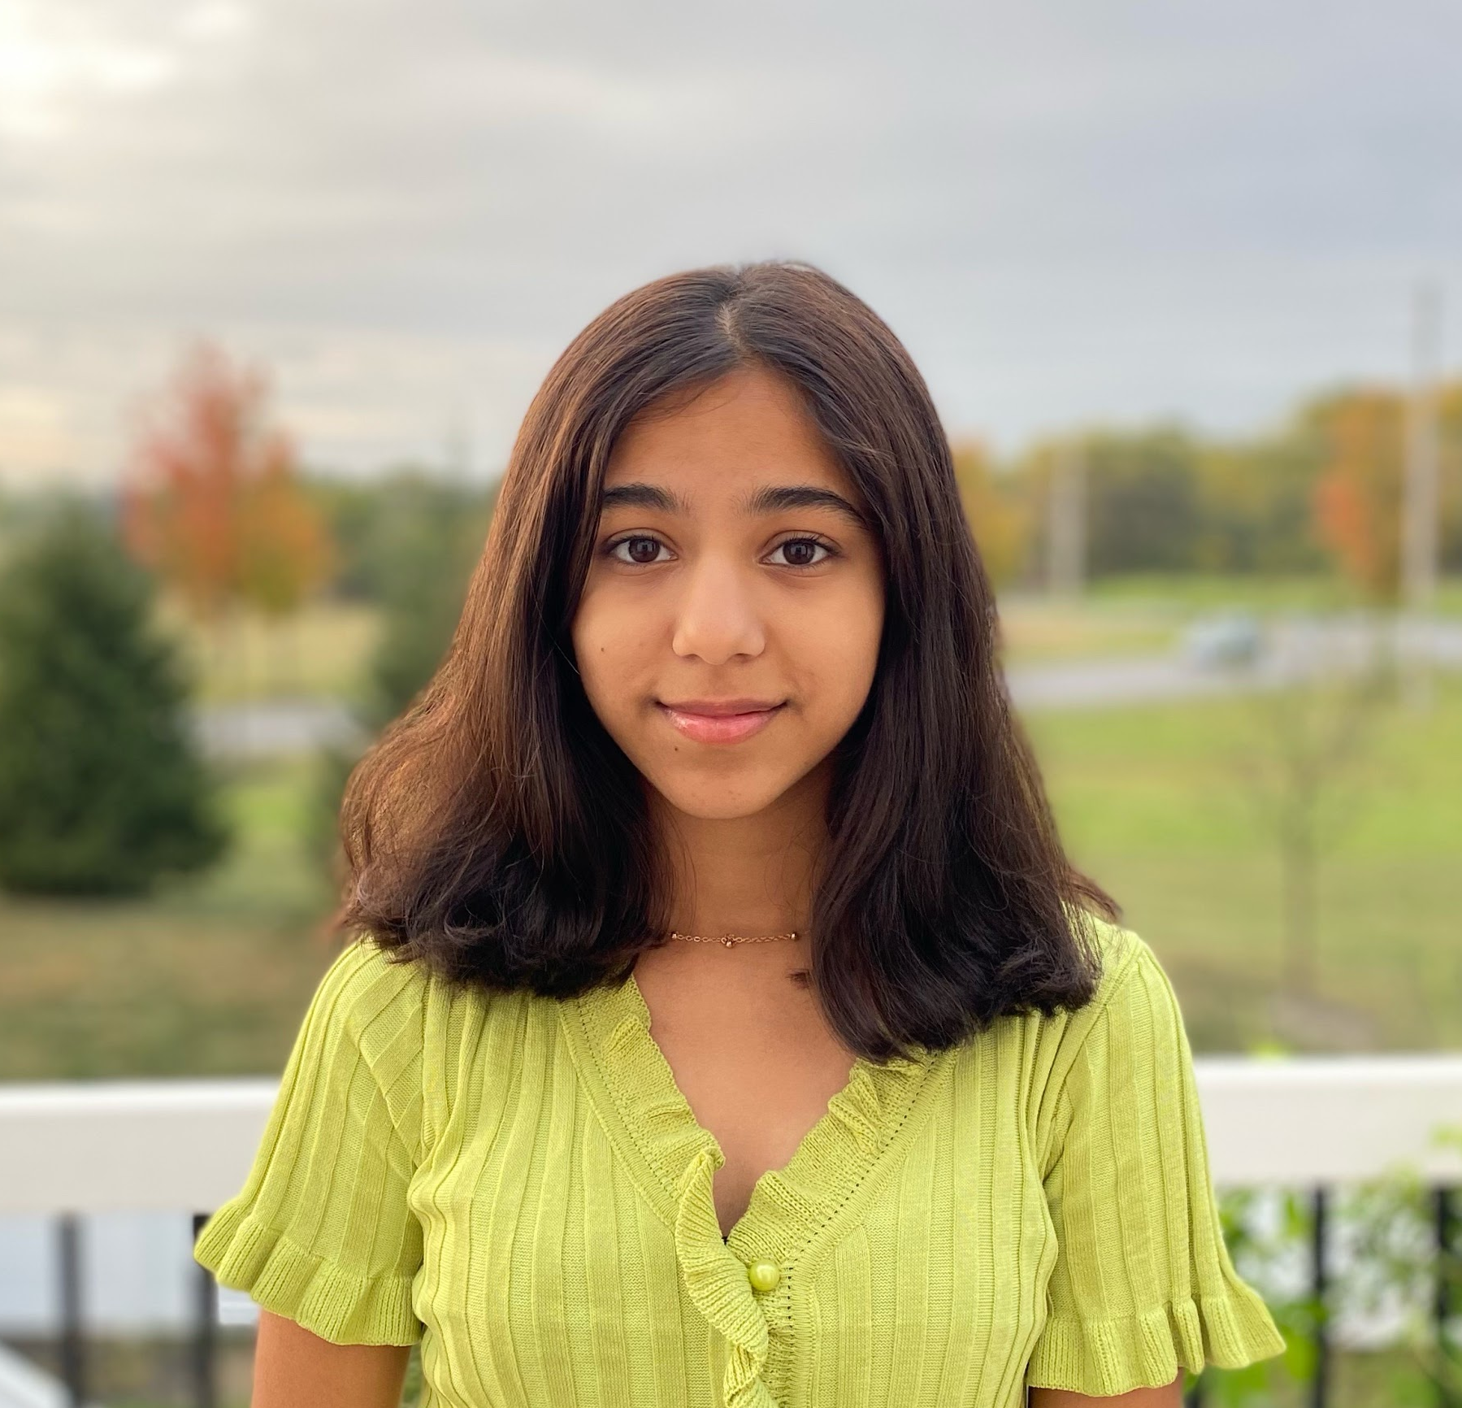
Team
Current High-School and First Year College Students
Near-Term Skills | Medium-Term Skills | Long-Term Skills
Case study conducting | Clinical Work | Informatics and Data Analysis
Market Research | App Development | Value Creation
Business Pitching | Brand Development | Relationship Management
Ujjayi Pamidigantam
Udgita Pamidigantam
Resources for Future Directions
Bhoomika Navandar
Karthik Karuppiah
Penn Medical School Network
5000+ student network of young stem professionals
Established relationships with MIT Bioengineering Department

Slide 12
Thank You!
Do you have any questions for CareBridge?

